Slide 1
Flask 페이지 설계
지우연

Slide 2
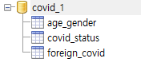
DataBase 설계(테이블)
age_gender: 연령별, 성별 코로나 현황
covid_status: 광역시도별 코로나 현황
foreign_covid: 코로나 해외 현황

Slide 3
DataBase 설계(age_gender)
date | text | not null | 집계 날짜
target | text | not null | 연령/성
confCase | int |  | 확진자 수
confRate | float |  | 확진자 비중(%)
criRate | float |  | 치명률(%)
death | int |  | 사망자 수
deathrate | float |  | 사망자 비중(%)

Slide 4
DataBase 설계(covid_status)
date | text | not null | 집계 날짜
region | text | not null | 광역시도
def_cnts | int |  | 확진자 수
local_occ | int |  | 국내발생 수
over_flow | int |  | 해외유입 수
inc_decs | int |  | 전일 대비 확진자
death_cnts | int |  | 사망자
isol_clr | int |  | 격리 해제
isol_ing | int |  | 격리 중
qur_rates | float |  | 10만명 당 발생률

Slide 5
DataBase 설계(foreign_covid)
date | text | not null | 집계 날짜
continent | text | not null | 지역(대륙)
nation | text | not null | 국가
natDef | int |  | 확진자 수
natDeath | int |  | 사망자 수
natDeathRate | float |  | 확진률 대비 사망률

Slide 6
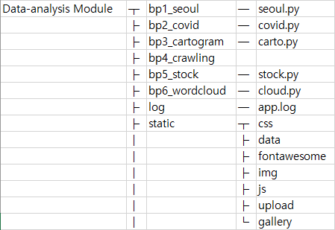
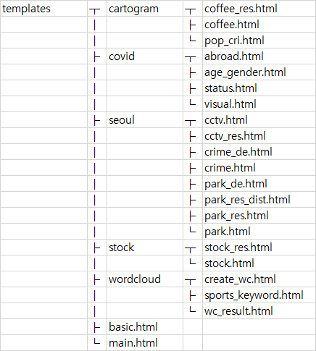
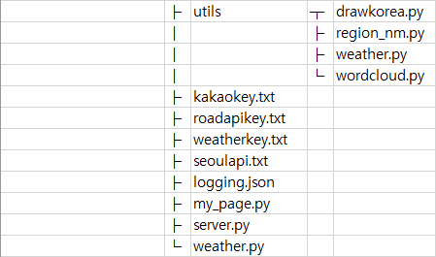
파일 구조 – 데이터 분석

Slide 7
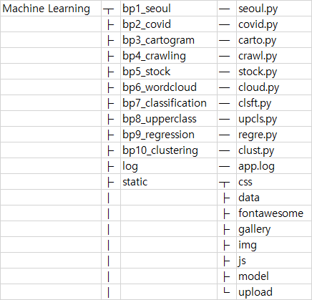
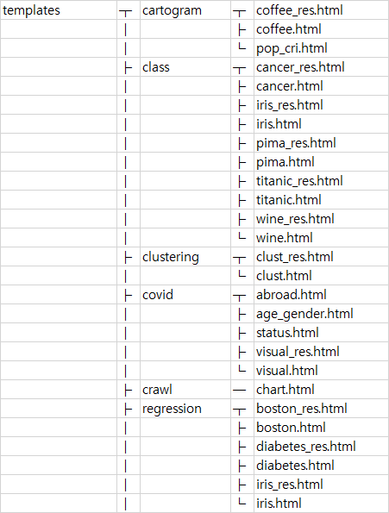
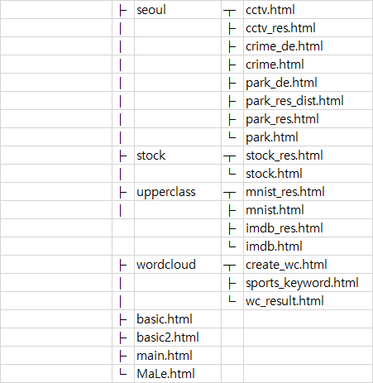
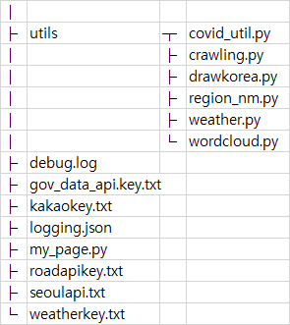
파일 구조 – 머신러닝

Slide 8
Routing - 메인
path | detail path | method | client -> server parameter | html파일 | server -> html params | 다음 행선지
/ |  | get |  |  |  | /main, /MaLe
/main |  | get |  | main.html | menu, weather | /seoul, /covid, /crawl, /stock, /carto, /cloud
/MaLe |  | get |  | MaLe.html | menu, weather | /class, /upcls, /regre, /clust,

Slide 9
Routing - /seoul
path | detail path | method | client -> server parameter | html파일 | server -> html params | 다음 행선지
/seoul |  |  |  |  |  | /seoul/park /seoul/park_de/area /seoul/crime /seoul/cctv
/seoul/park |  | get |  | park.html | menu, weather, park_list, dist_list, mtime | park_res.html park_res_dist.html
 |  | post | distinct, name/dist | park_res.html park_res_dist.html | menu, weather, park_result/ dist_result, mtime
/seoul/park_de | /area | get | option | park_de.html | menu, weather, option, option_dict, mtime
 | /count
 | /area_ratio
 | /per_person

Slide 10
Routing - /seoul
path | detail path | method | client -> server parameter | html파일 | server -> html params | 다음 행선지
/seoul/crime |  |  |  |  |  | /crime_de/violence, /crime_de/rape, /crime_de/theft, /crime_de/robbery, /crime_de/murder, /crime_de/violence_arr, /crime_de/rape_arr, /crime_de/theft_arr, /crime_de/robbery_arr, /crime_de/murder_arr
/seoul/crime_de | /violence | get | option | crime_de.html | menu, weather, option, option_dict1, option_dict2, column_index, mtime
 | /rape
 | /theft
 | /robbery
 | /murder
 | /violence_arr | post
 | /rape_arr
 | /theft_arr
 | /robbery_arr
 | /murder_arr

Slide 11
Routing - /seoul
path | detail path | method | client -> server parameter | html파일 | server -> html params | 다음 행선지
/seoul/cctv |  | get |  | cctv.html |  | cctv_res.html
 |  | post | kind | cctv_res.html | kind, menu, weather, mtime

Slide 12
Routing - /covid
path | detail path | method | client -> server parameter | html파일 | server -> html params | 다음 행선지
/covid |  |  |  |  |  | /covid/national_status, /covid/age_gender, /covid/abroad, /covid/visual
/covid/national_status |  | get |  | status.html | menu, weather, rows, date | /covid/update_status
/covid/update_status | <date> | get | date
/covid/age_gender |  | get |  | age_gender.html | menu, weather, rows, date | /covid/update_age_gender
/covid/update_age_gender | <date> | get | date
/covid/abroad |  | get |  | abroad.html | menu, weather, rows, date | /covid/update_abroad
/covid/update_abroad | <date> | get | date
/covid/visual |  | get |  | visual.html | menu, weather, mtime, regions | visual_res.html
 |  | post | district | visual_res.html | menu, weather, mtime

Slide 13
Routing - /carto
path | detail path | method | client -> server parameter | html파일 | server -> html params | 다음 행선지
/carto |  |  |  |  |  | /carto/pop_crisis, /carto/coffee
/carto/pop_crisis | /crisis_area | get | option | pop_cri.html | menu, weather, mtime, option, columns
 | /crisis_ratio
/carto/coffee |  | get |  | coffee.html | menu, weather | coffee_res.html
/covid/update_age_g | <date> | post | carto_list, csv | coffee_res.html | menu, weather, carto, mtime, top10

Slide 14
Routing - /crawl
path | detail path | method | client -> server parameter | html파일 | server -> html params | 다음 행선지
/crawl |  |  |  |  |  | /crawl/chart
/crawl/chart |  | get |  | chart.html | menu, weather, bugs, melon, genie

Slide 15
Routing - /cloud
path | detail path | method | client -> server parameter | html파일 | server -> html params | 다음 행선지
/cloud |  |  |  |  |  | /cloud/create_wc, /cloud/sports_keyword
/cloud/create_wc |  | get |  | create_wc.html | menu, weather | wc_result.html
 | /crisis_ratio | post | lang, txt, mask, stopwords | wc_result.html | menu, weather, mtime
/cloud/sports_keyword |  | get |  | sports_keyword.html | menu, weather, mtime

Slide 16
Routing - /class
path | detail path | method | client -> server parameter | html파일 | server -> html params | 다음 행선지
/class |  |  |  |  |  | /class/cancer
/class/cancer |  | get |  | cancer.html | menu, weather | cancer_res.html
/covid/update_age_g | <date> | post | index | cancer_res.html | menu, weather, result
/class/pima |  | get |  | pima.html | menu, weather | pima_res.html
 |  | post | index | pima_res.html | menu, weather, dict
/class/titanic |  | get |  | titanic.html | menu, weather | titanic_res.html
 |  | post | index | titanic_res.html | menu, weather, dict
/class/iris |  | get |  | iris.html | menu, weather | iris_res.html
 |  | post | index | iris_res.html | menu, weather, dict
/class/wine |  | get |  | wine.html | menu, weather | wine_res.html
 |  | post | index | wine_res.html | menu, weather, dict

Slide 17
Routing - /upcls
path | detail path | method | client -> server parameter | html파일 | server -> html params | 다음 행선지
/upcls |  |  |  |  |  | /upcls/mnist
/upcls/mnist |  | get |  | mnist.html | menu, weather | mnist_res.html
/covid/update_age_g | <date> | post | index | mnist_res.html | menu, weather, dict, mtime
/upcls/IMDB |  | get |  | imdb.html | menu, weather | imdb_res.html
 |  | post | select, review, index | imdb_res.html | menu, weather, p_c, p_t, review

Slide 18
Routing - /regre
path | detail path | method | client -> server parameter | html파일 | server -> html params | 다음 행선지
/regre |  |  |  |  |  | /regre/iris
/regre/iris |  | get |  | iris.html | menu, weather | iris_res.html
/covid/update_age_g | <date> | post | index, feature | iris_res.html | menu, weather, pred, index, X, feature, ft_name
/regre/diabetes |  | get |  | diabetes.html | menu, weather, list | diabete_res.html
 |  | post | index, feature | diabetes_res.html | menu, weather, pred, index, feature, list, label, mtime
/regre/boston |  | get |  | boston.html | menu, weather, columns | boston_res.html
 |  | post | index, feature | boston_res.html | menu, weather, dict

Slide 19
Routing - /clust
path | detail path | method | client -> server parameter | html파일 | server -> html params | 다음 행선지
/clust |  |  |  |  |  | /clust/clust
/clust/clust |  | get |  | clust.html | menu, weather | clust_res.html
/covid/update_age_g | <date> | post | file, n | clust_res.html | menu, weather, mtime, n_cluster

Slide 20
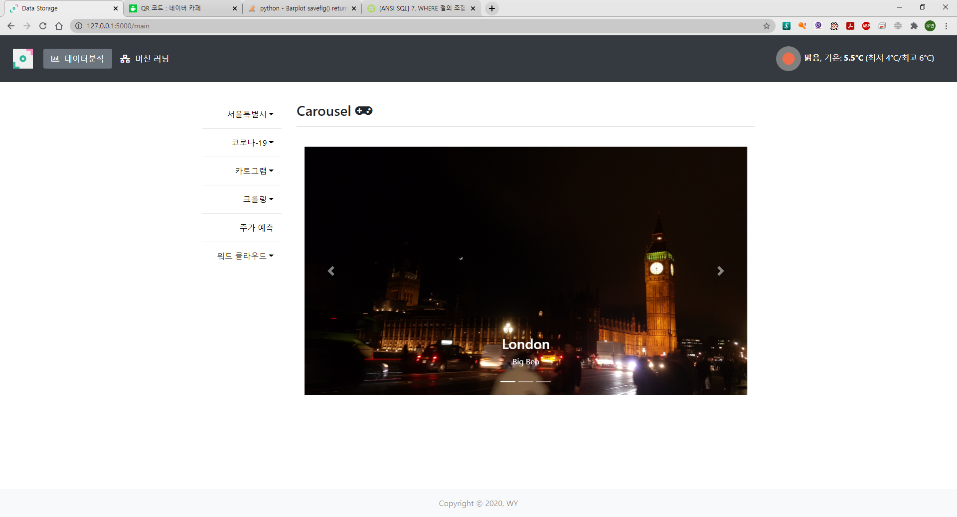
main 화면

Slide 21
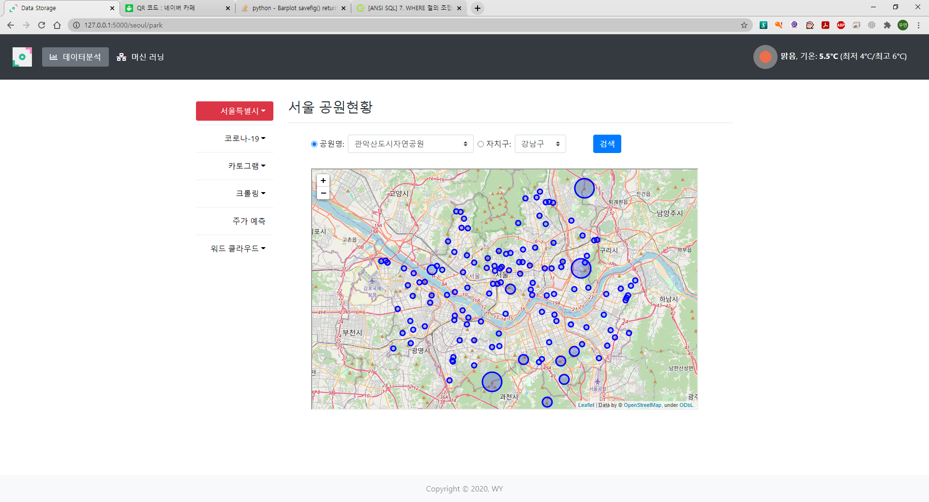

Slide 22
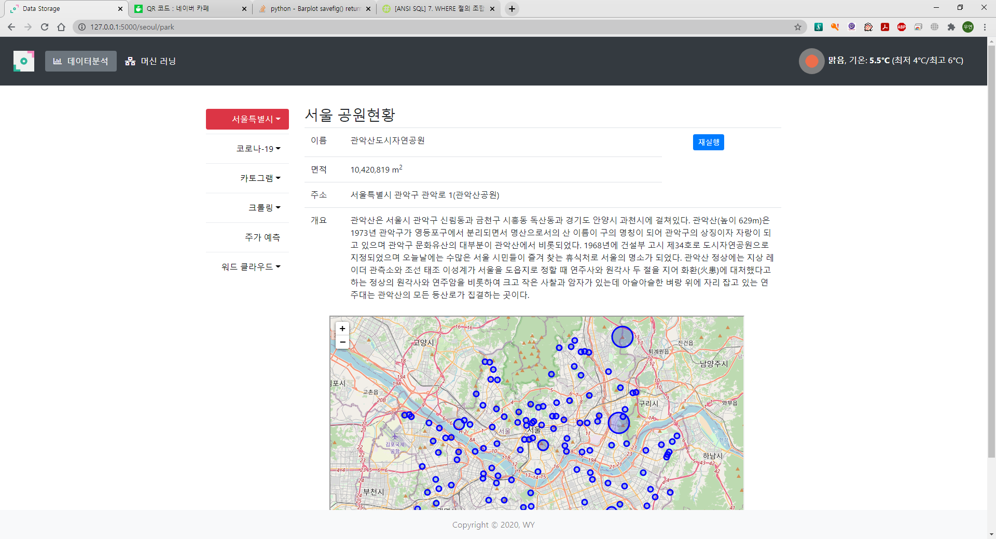
공원 정보 입력 후

Slide 23
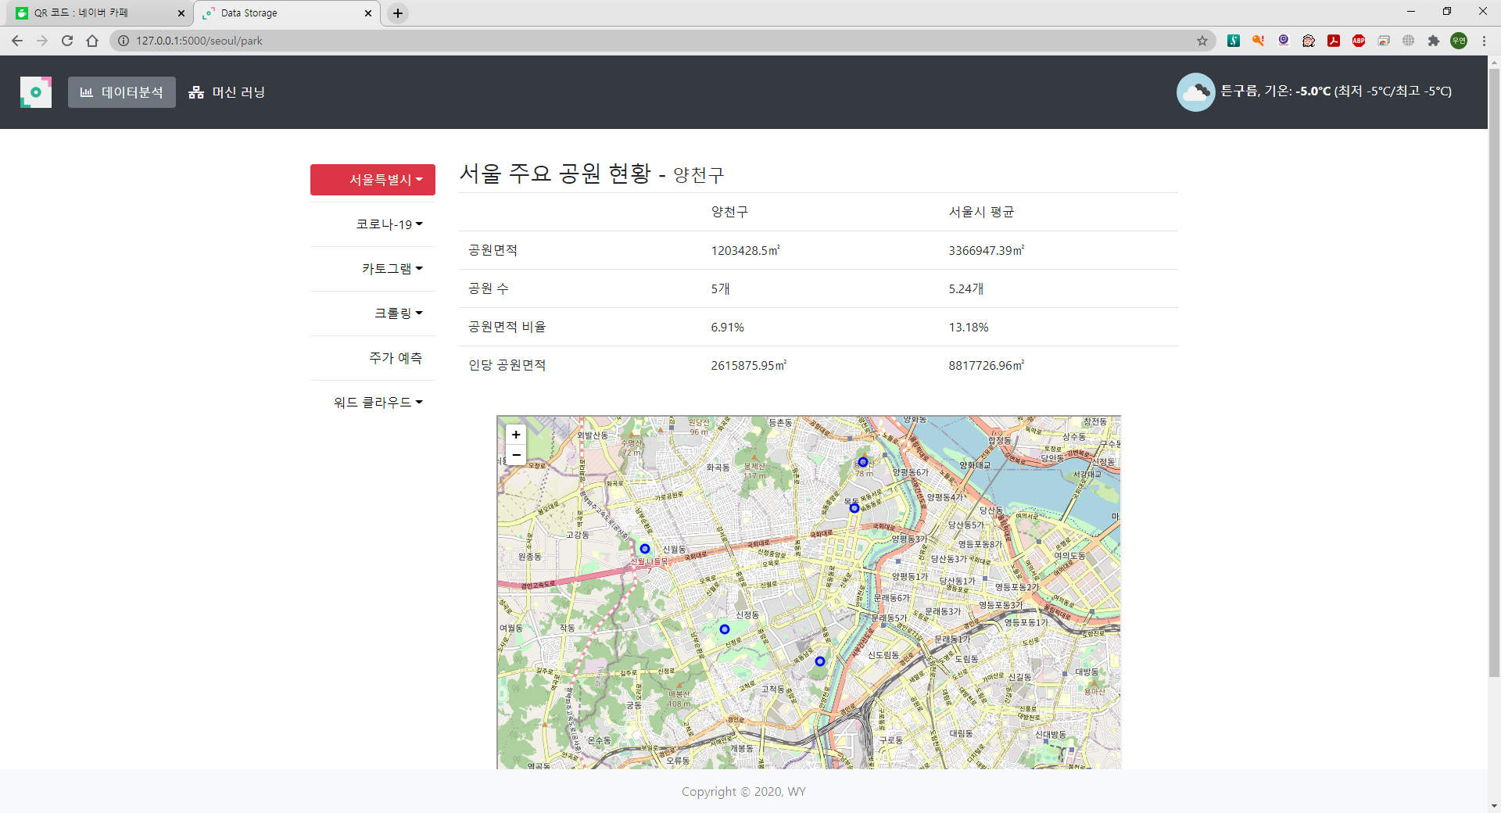
구 정보 입력 후

Slide 24
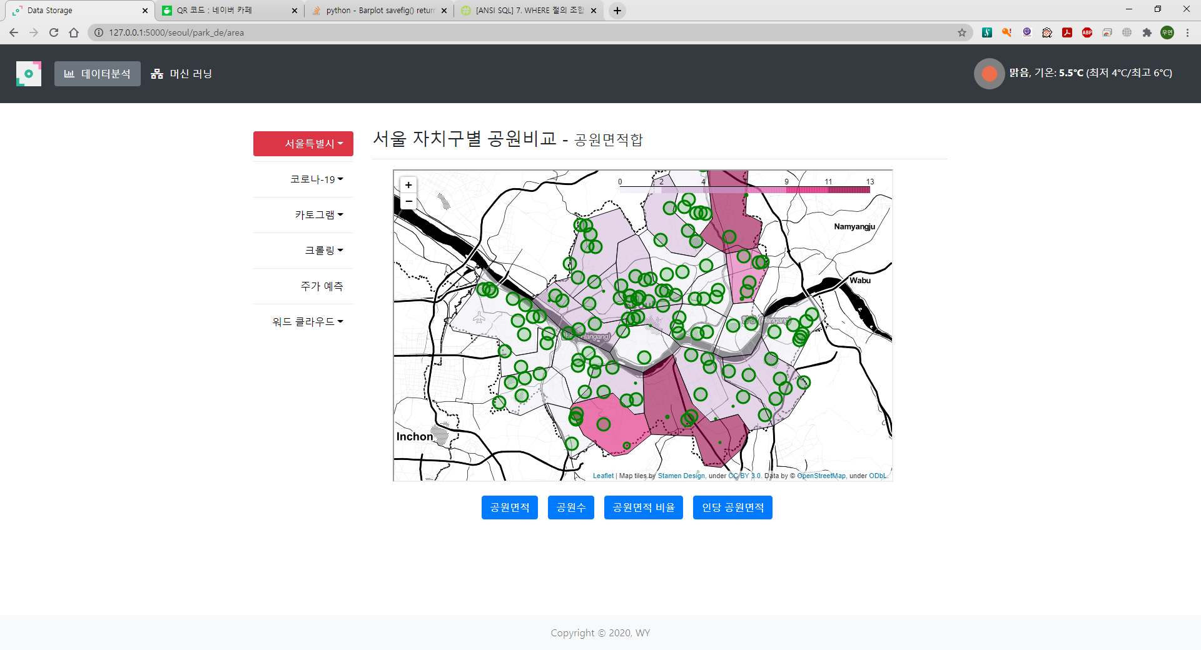

Slide 25
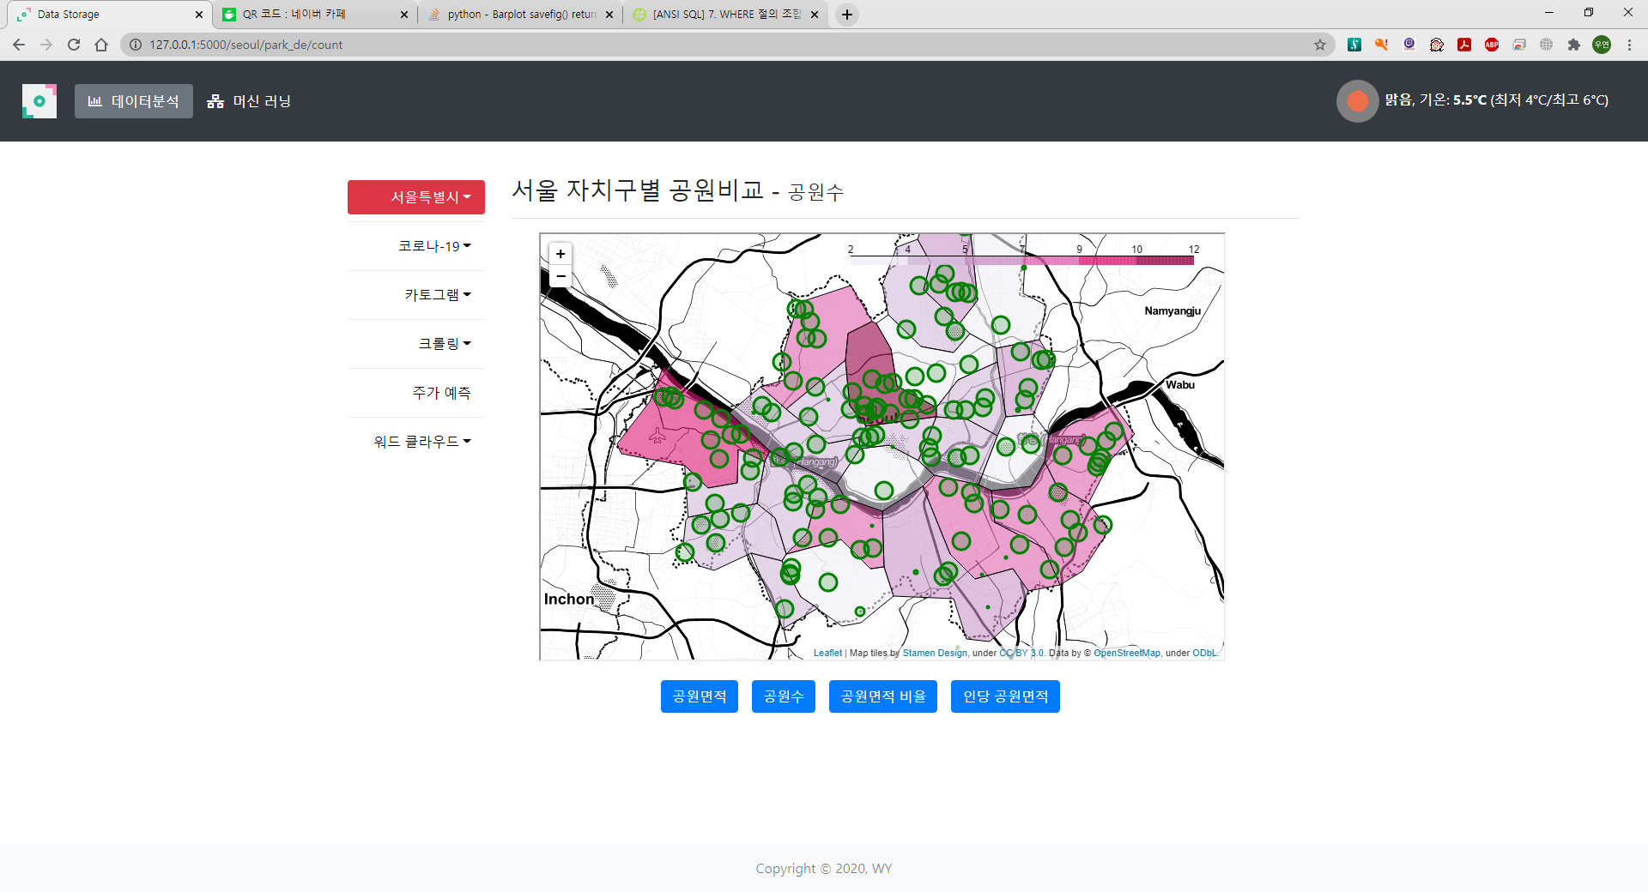

Slide 26
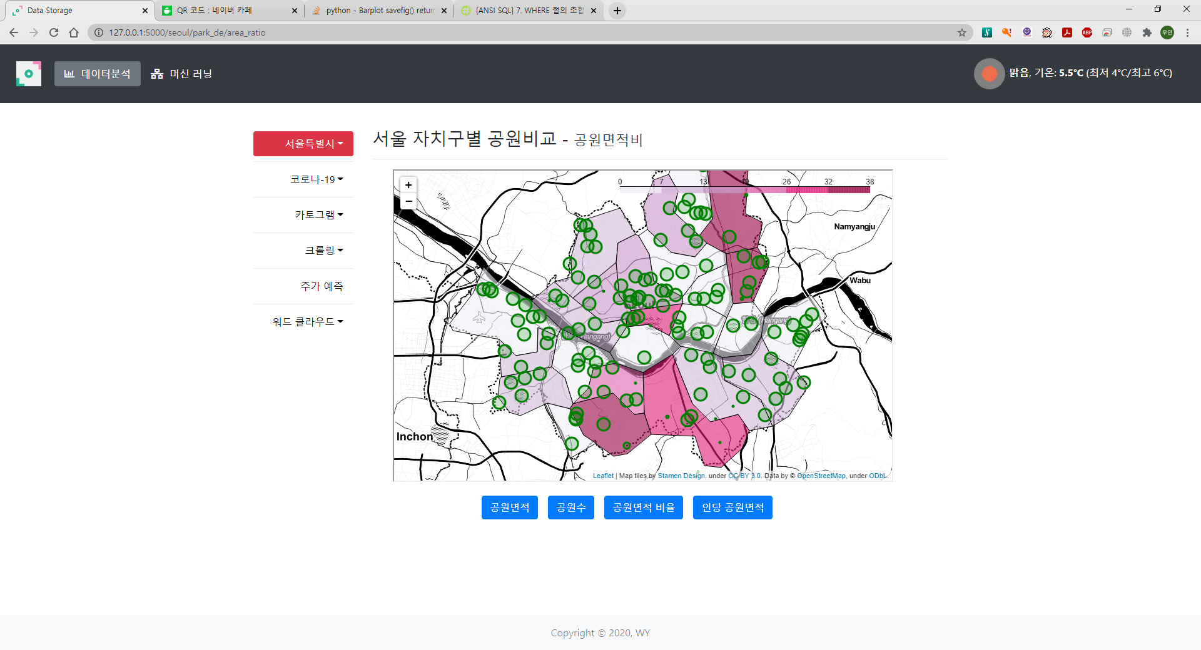

Slide 27
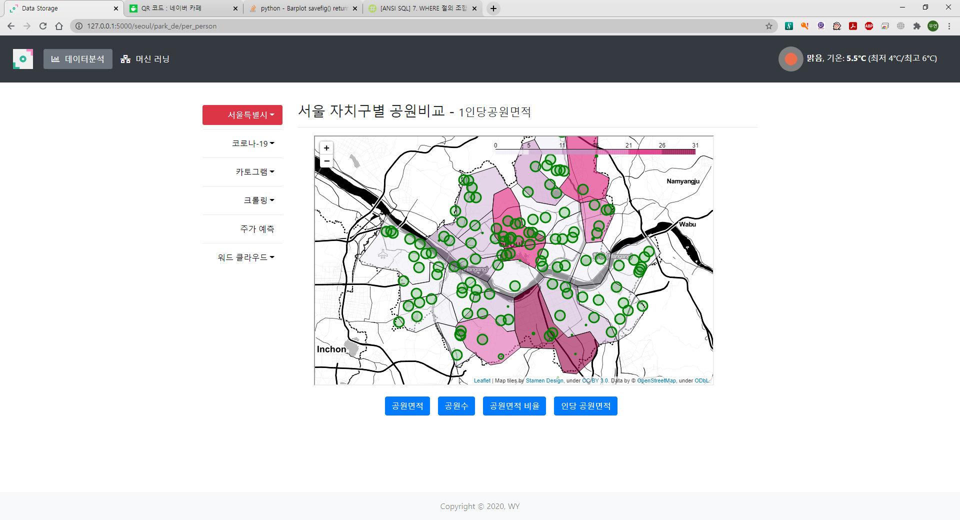

Slide 28
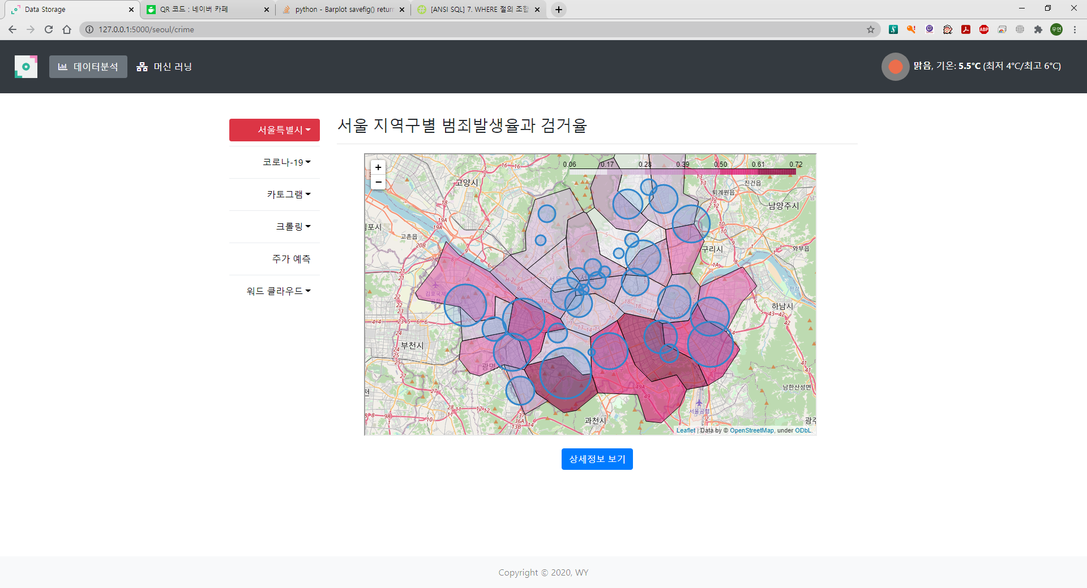

Slide 29
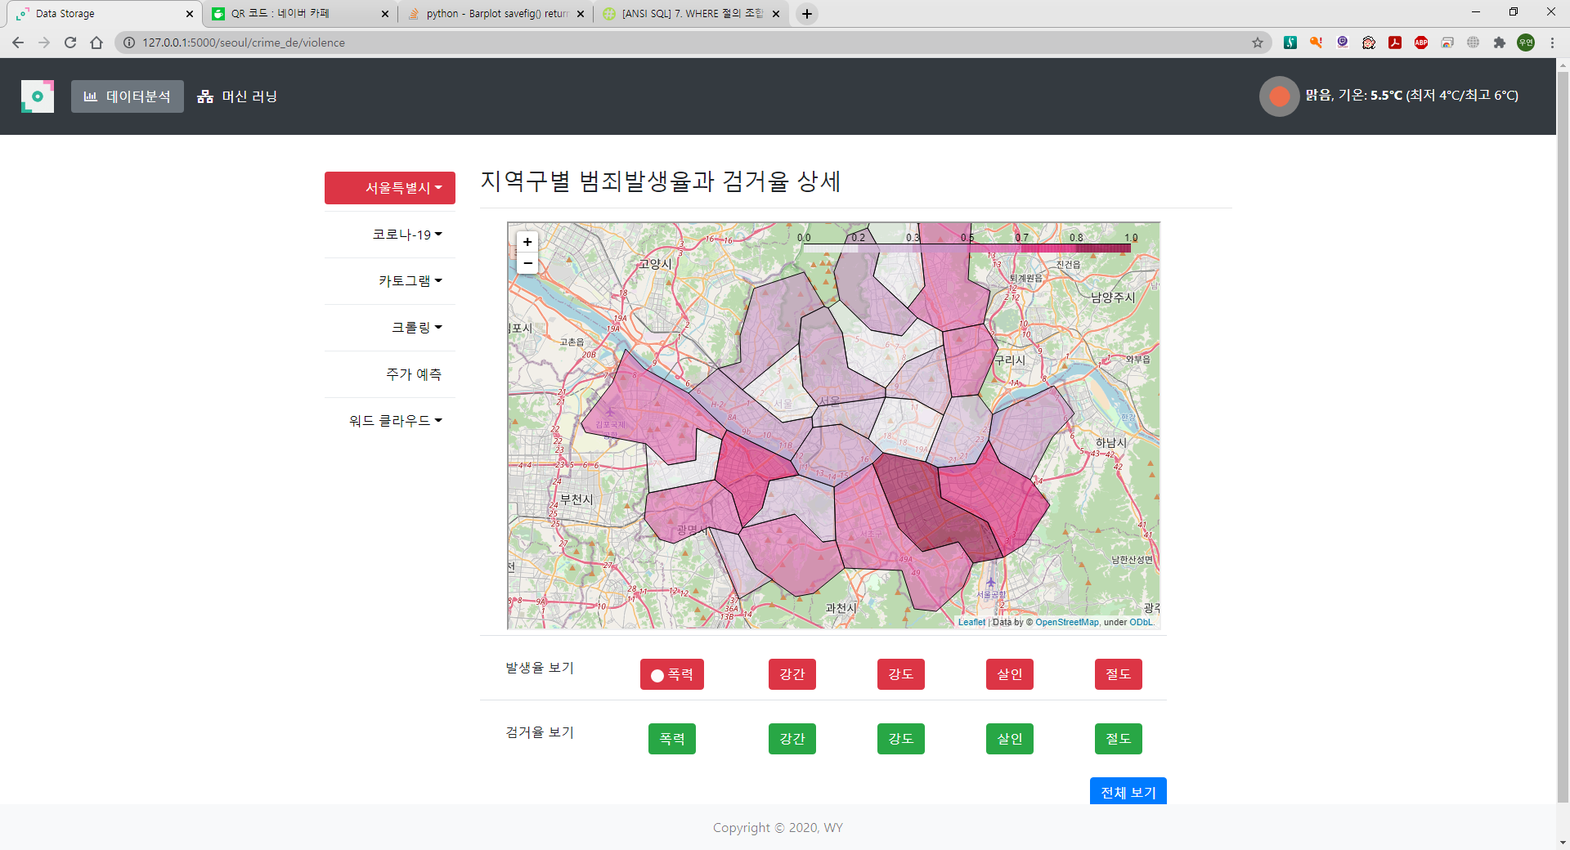
상세 보기 클릭 후
- 발생율

Slide 30
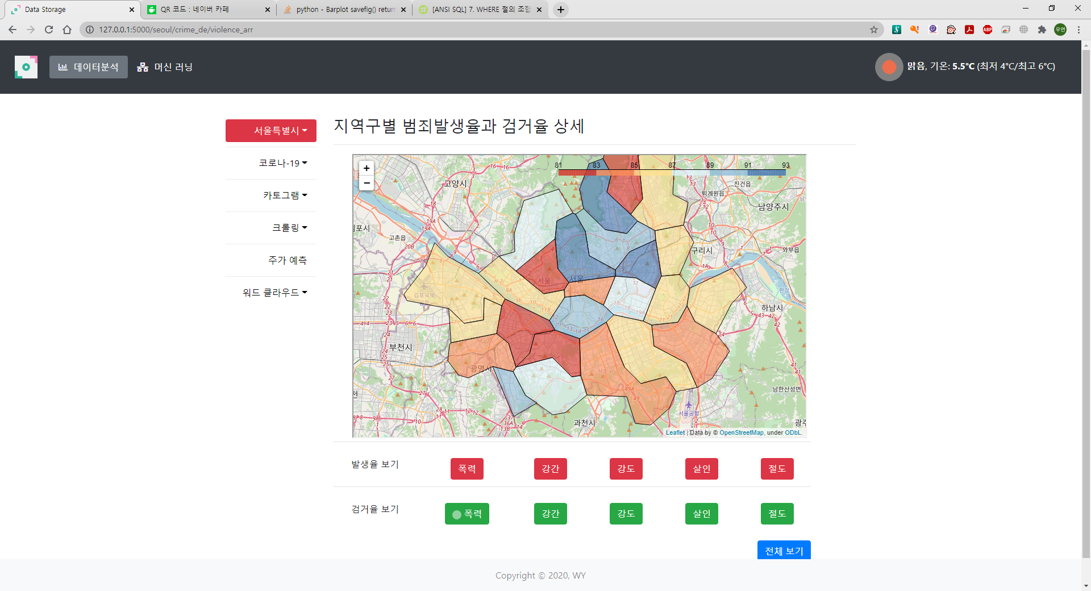
검거율 화면

Slide 31
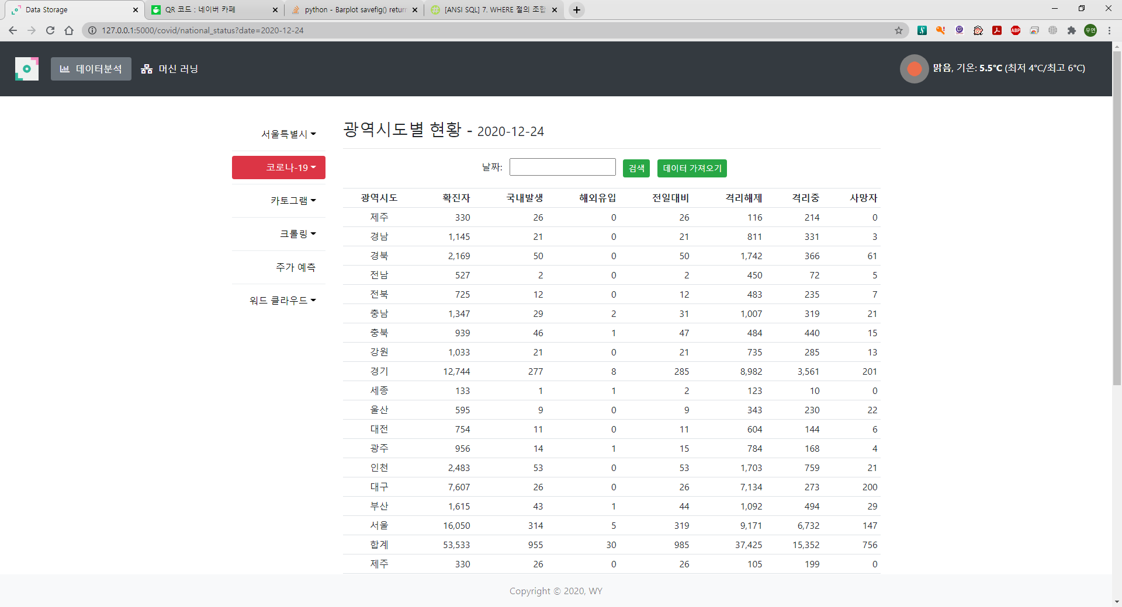

Slide 32
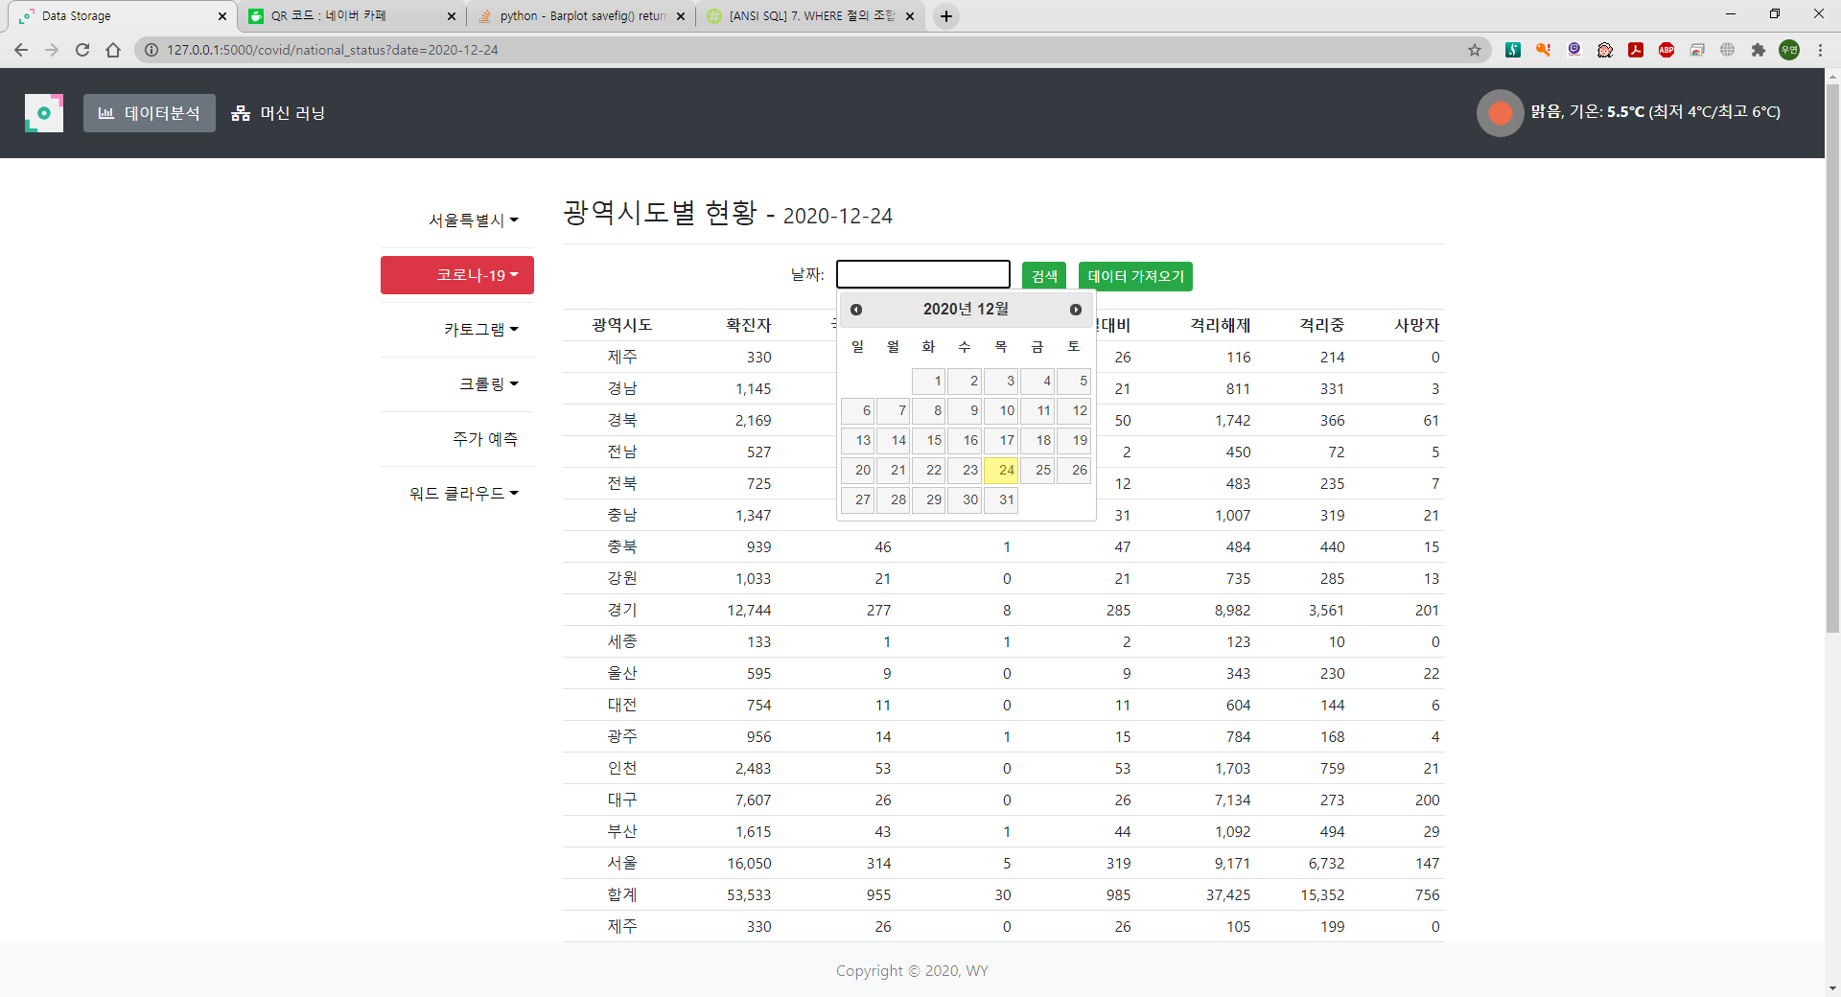
날짜 선택

Slide 33
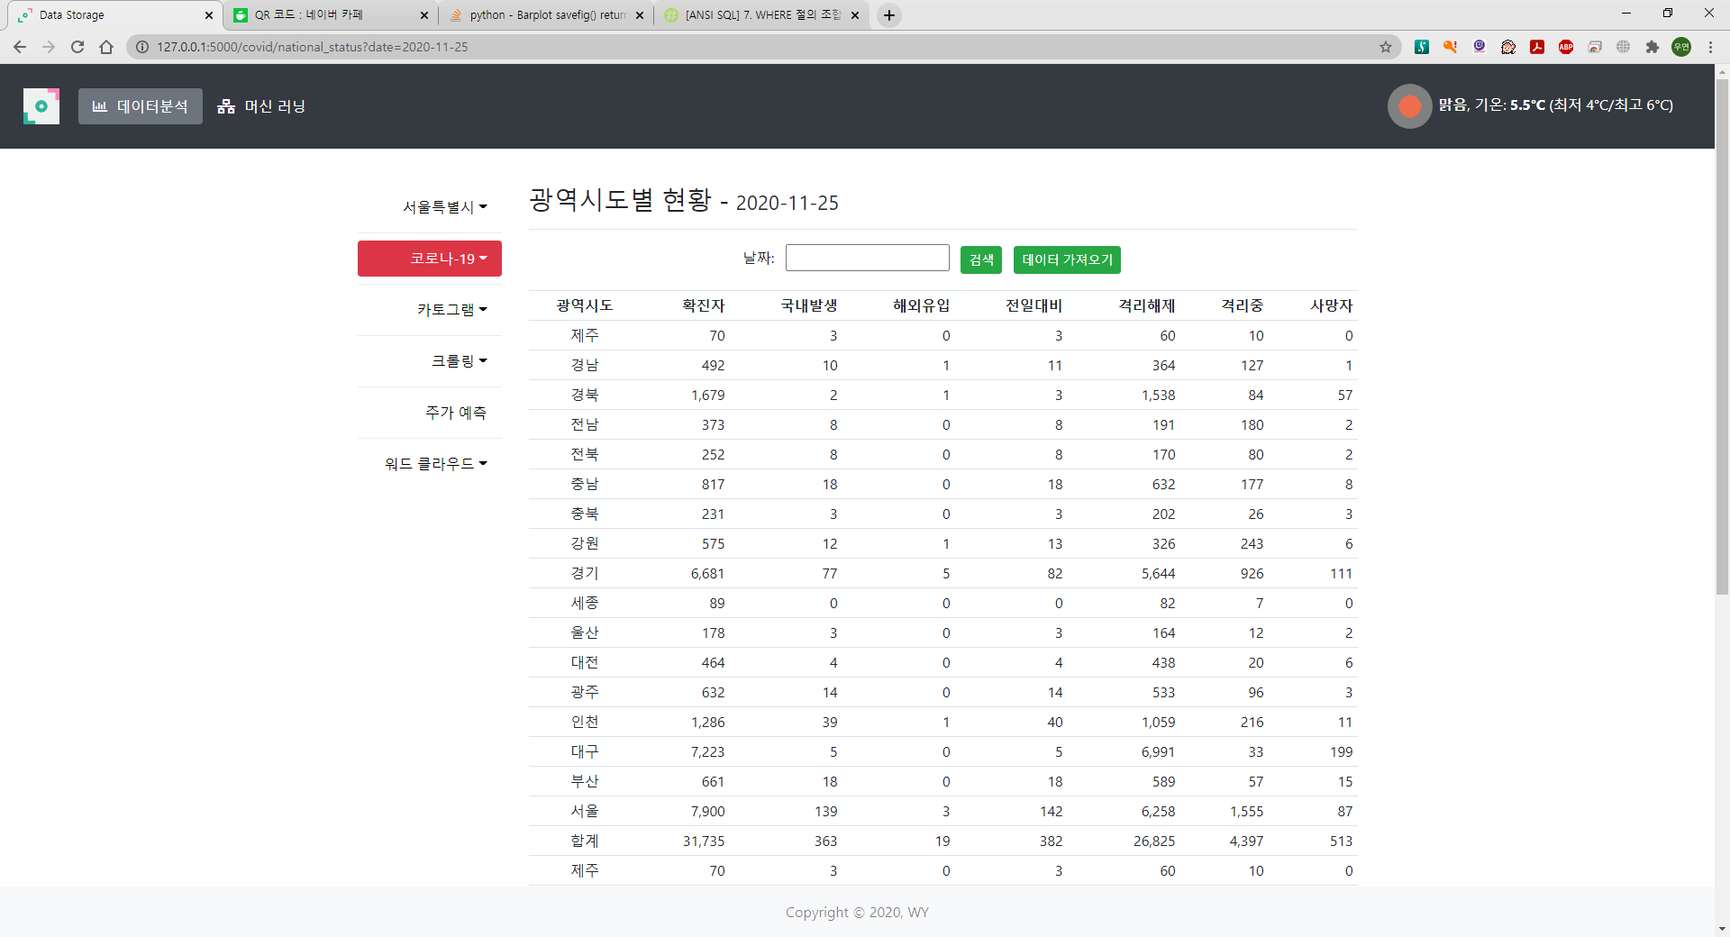

Slide 34
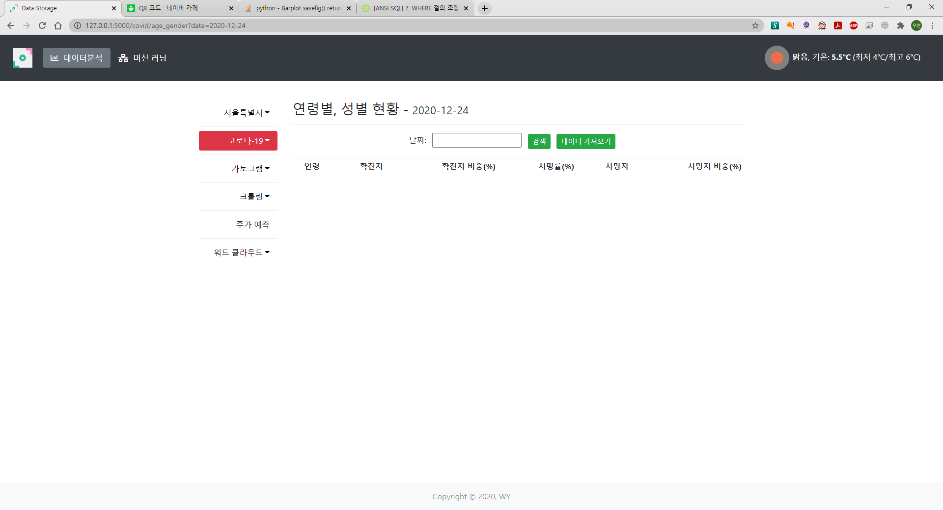

Slide 35
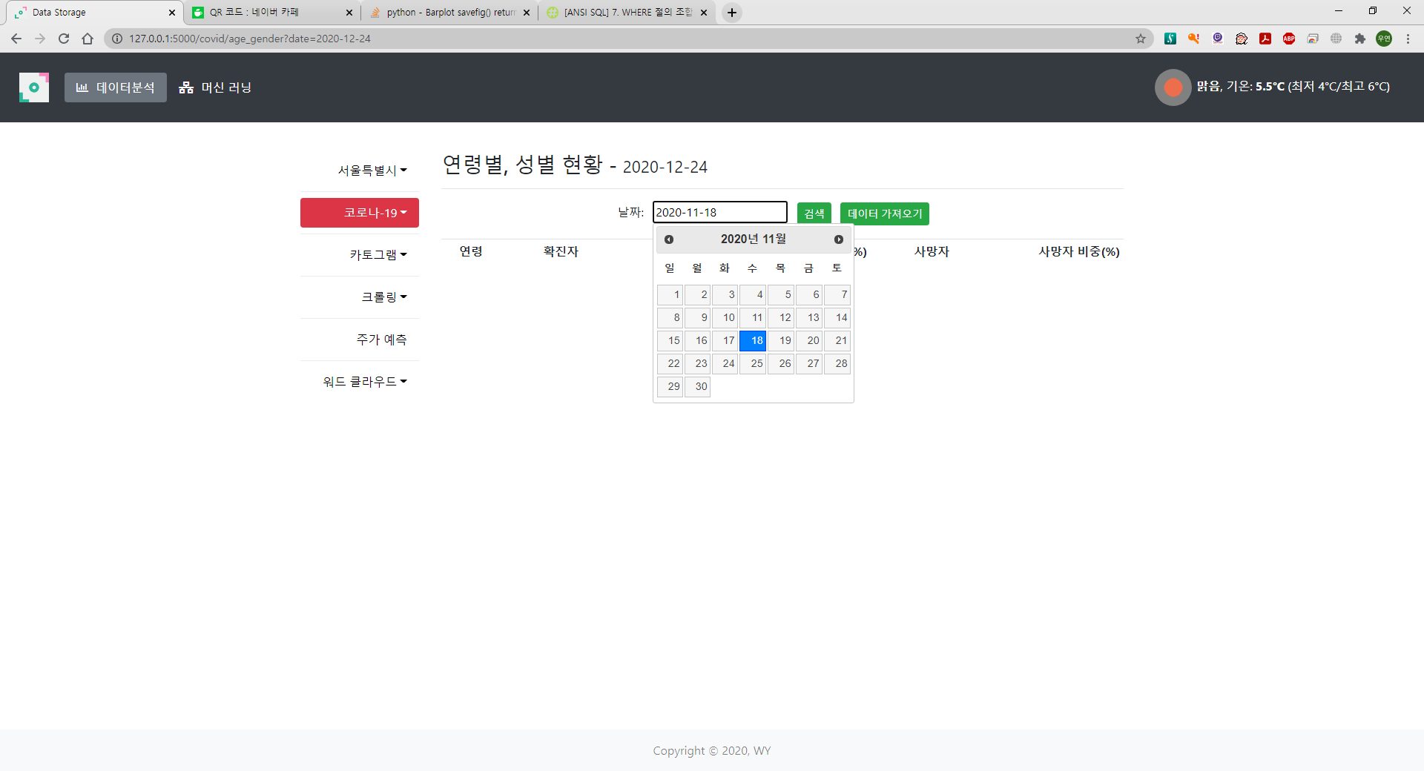
날짜 선택

Slide 36
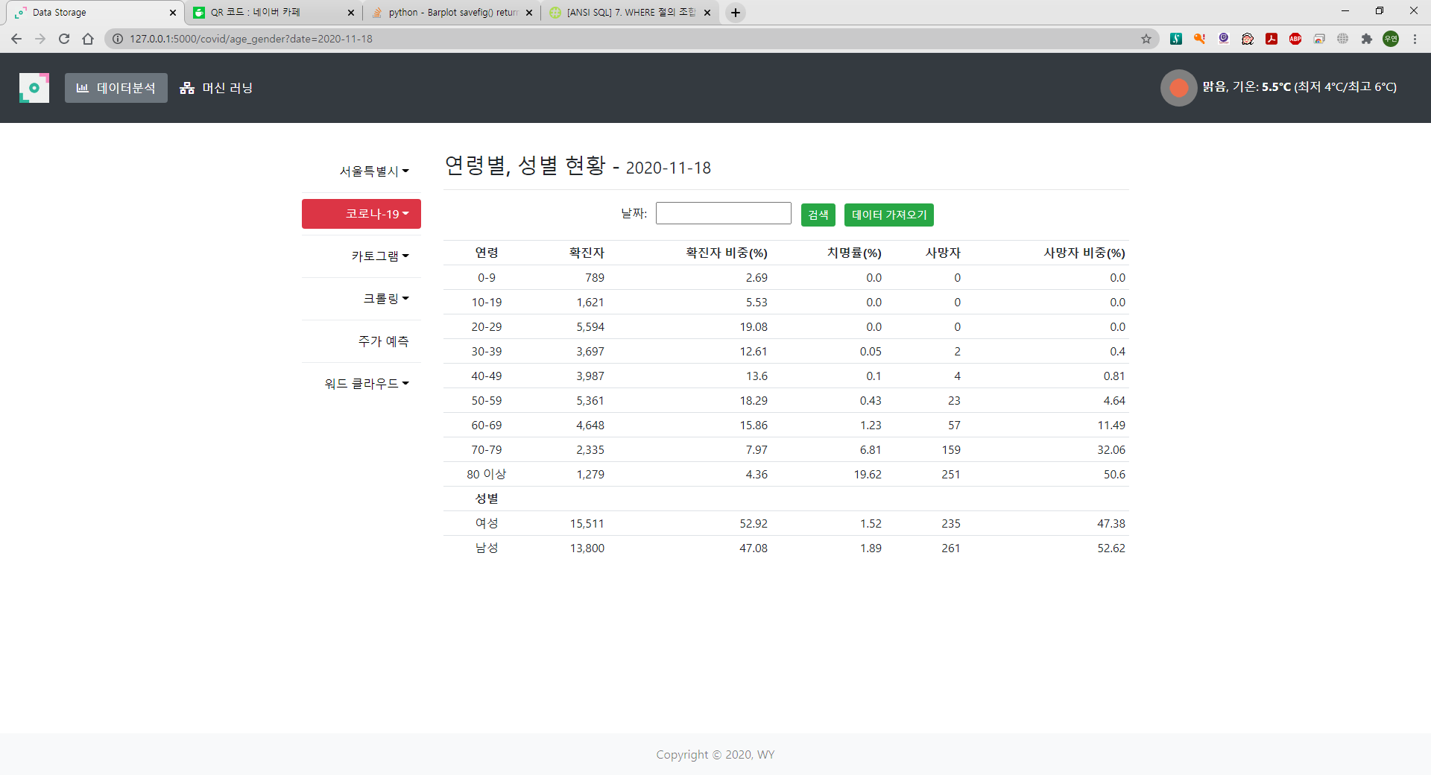

Slide 37
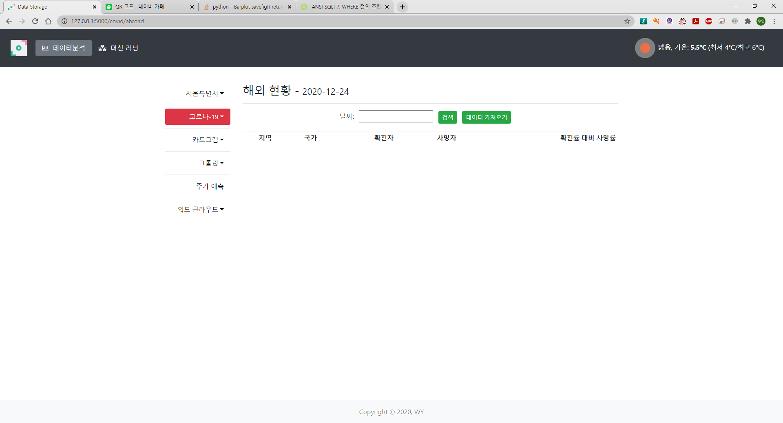

Slide 38
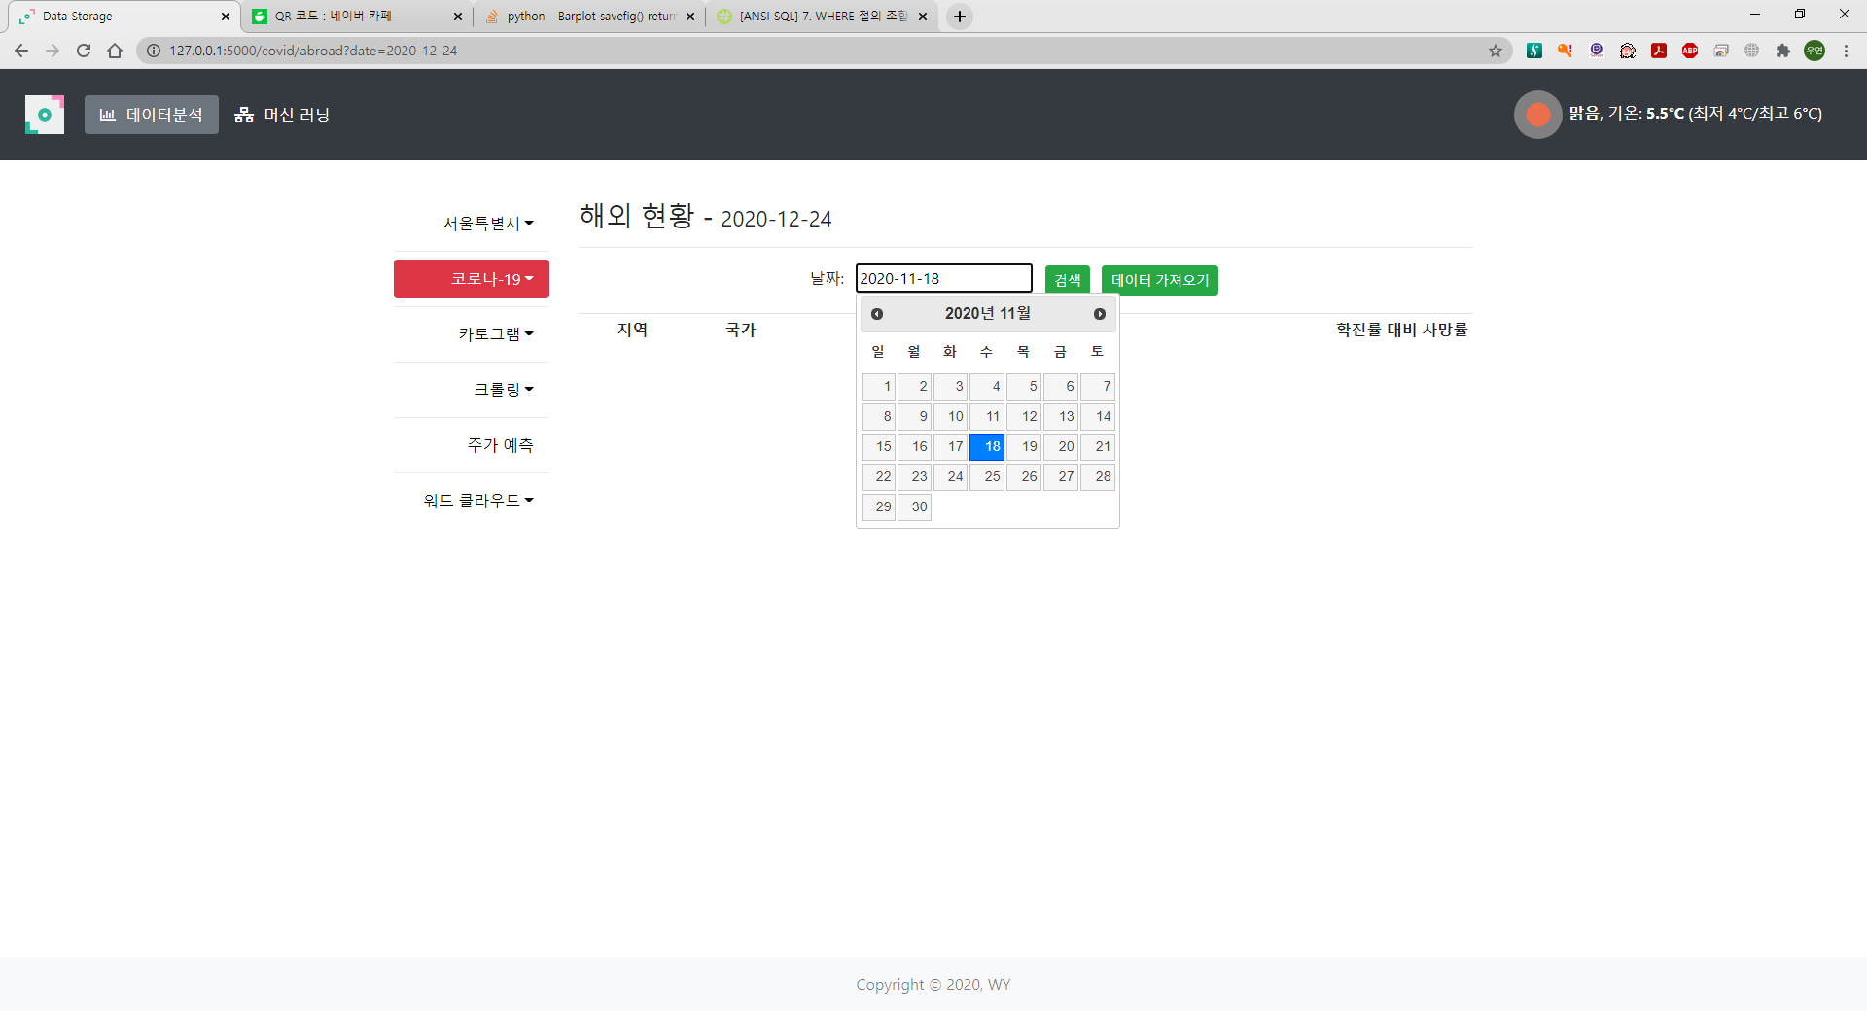
날짜 선택

Slide 39
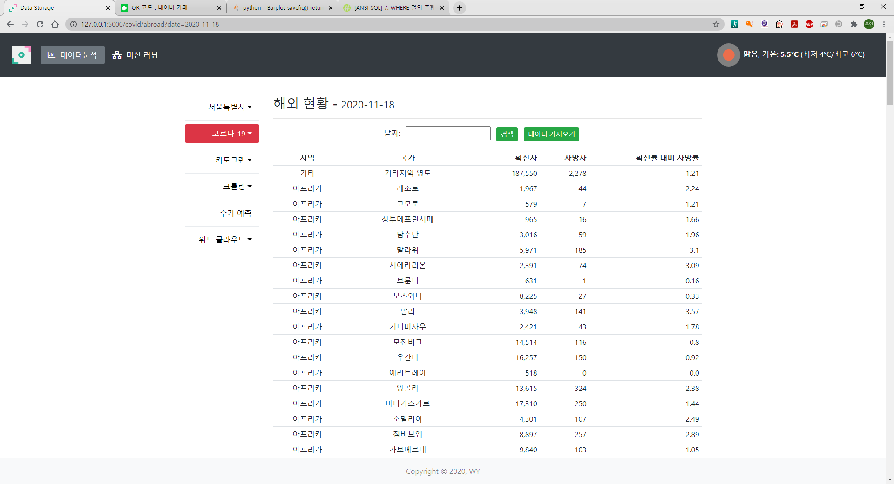

Slide 40
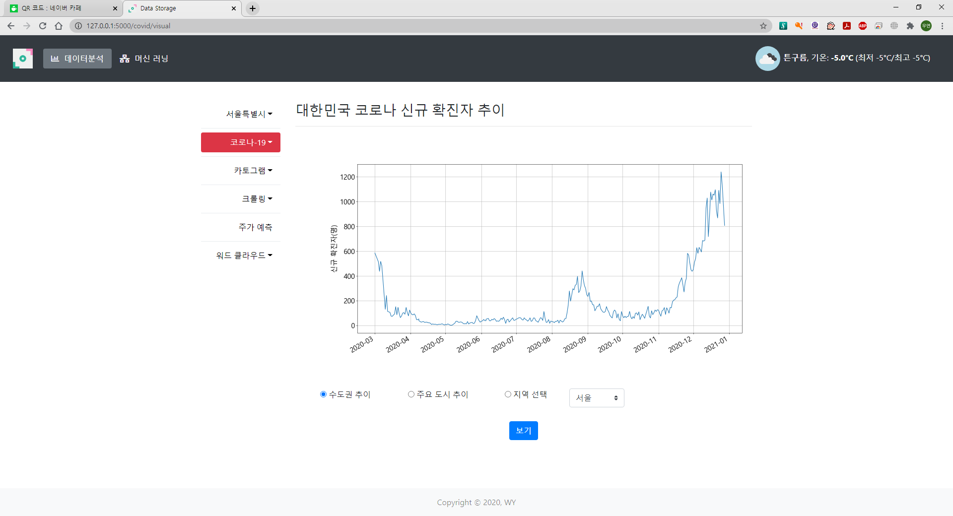

Slide 41
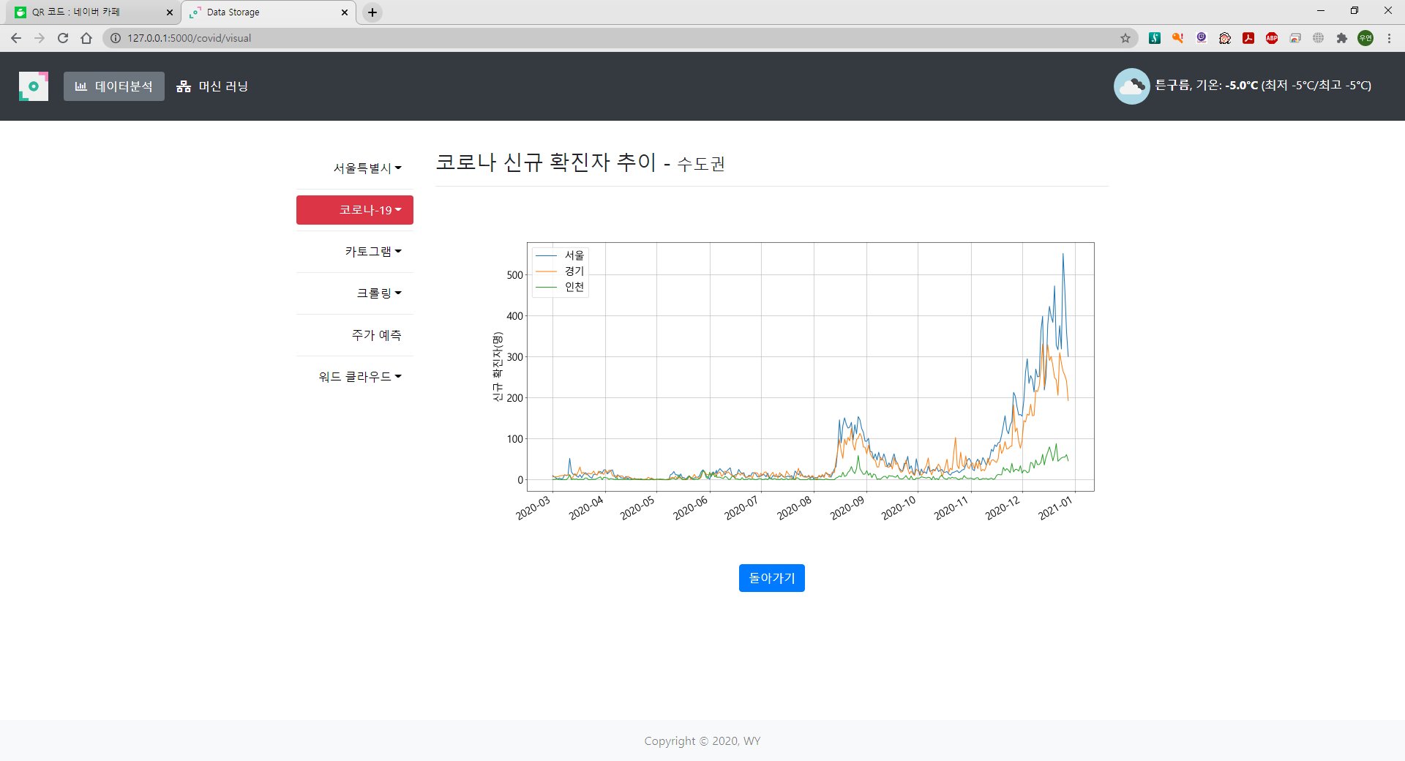
수도권 추이

Slide 42
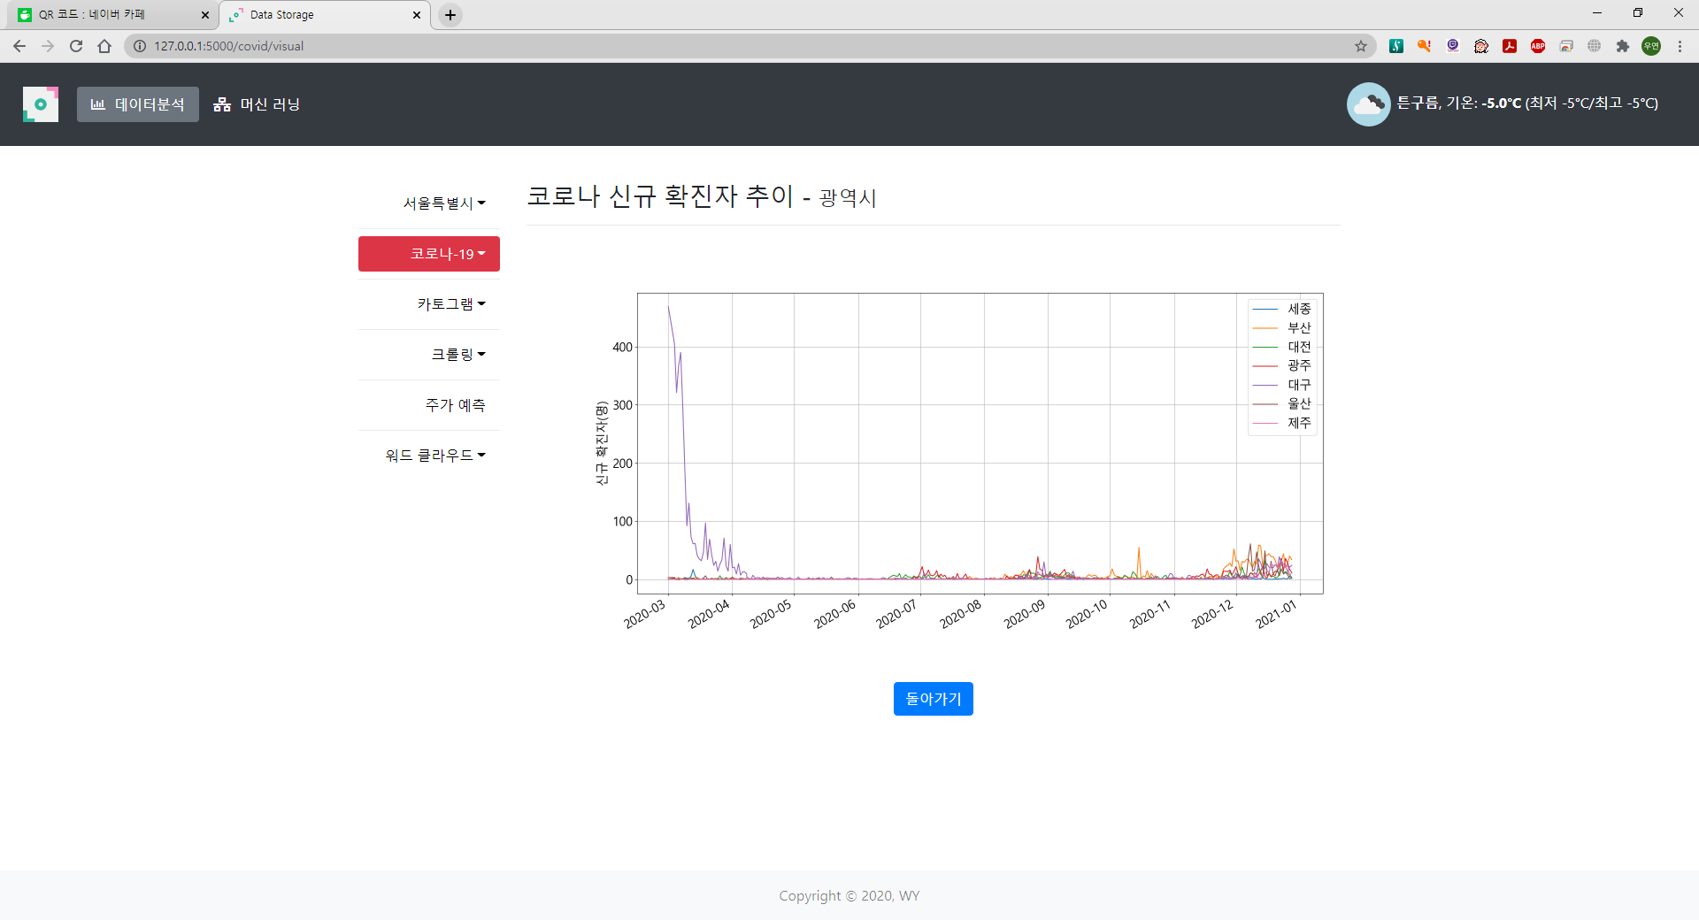
주요 도시 추이

Slide 43
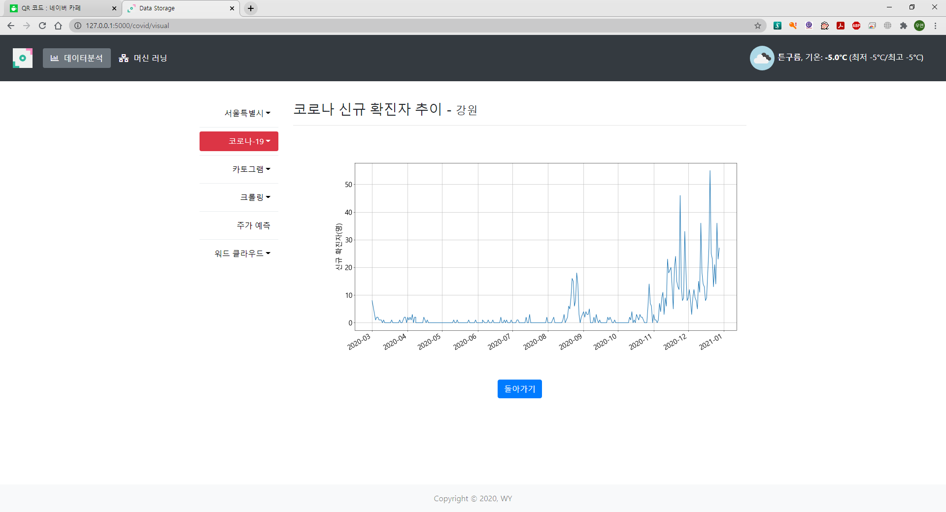
선택한 도시 추이

Slide 44
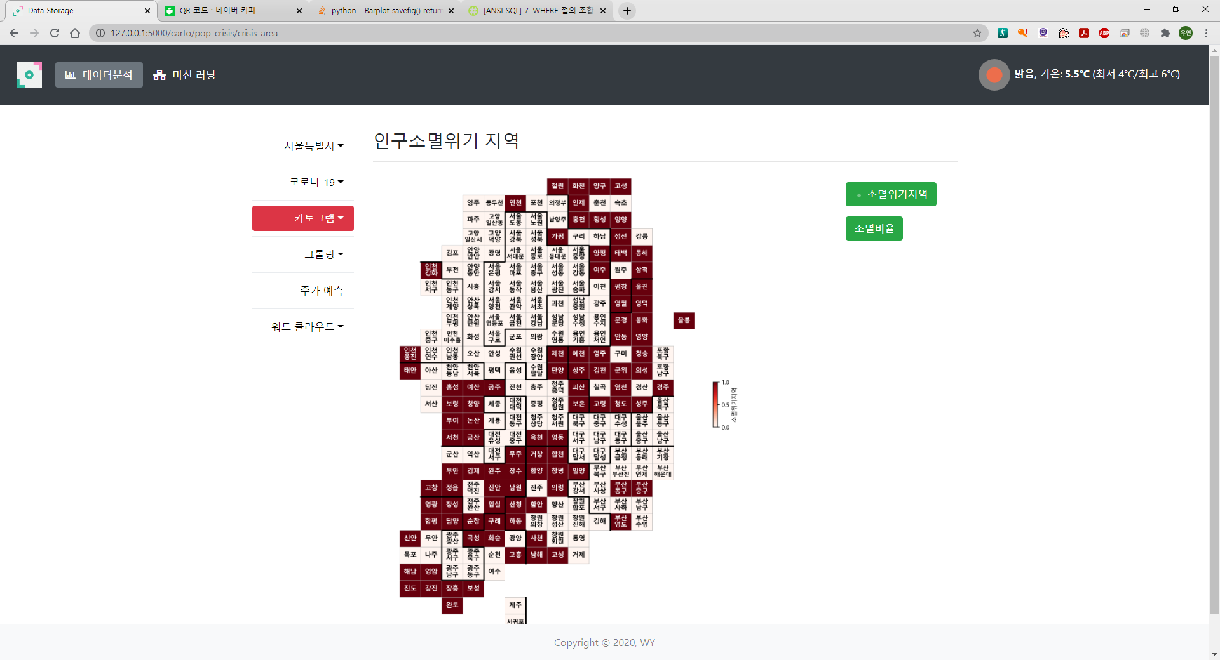

Slide 45
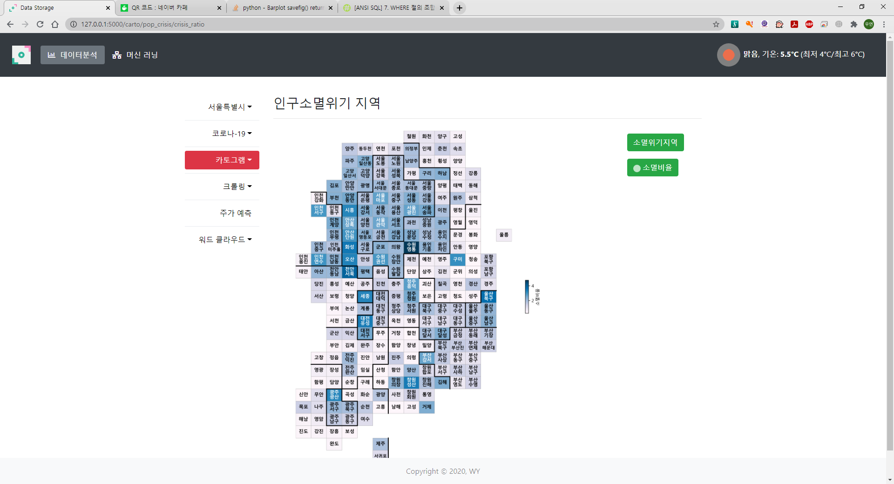

Slide 46
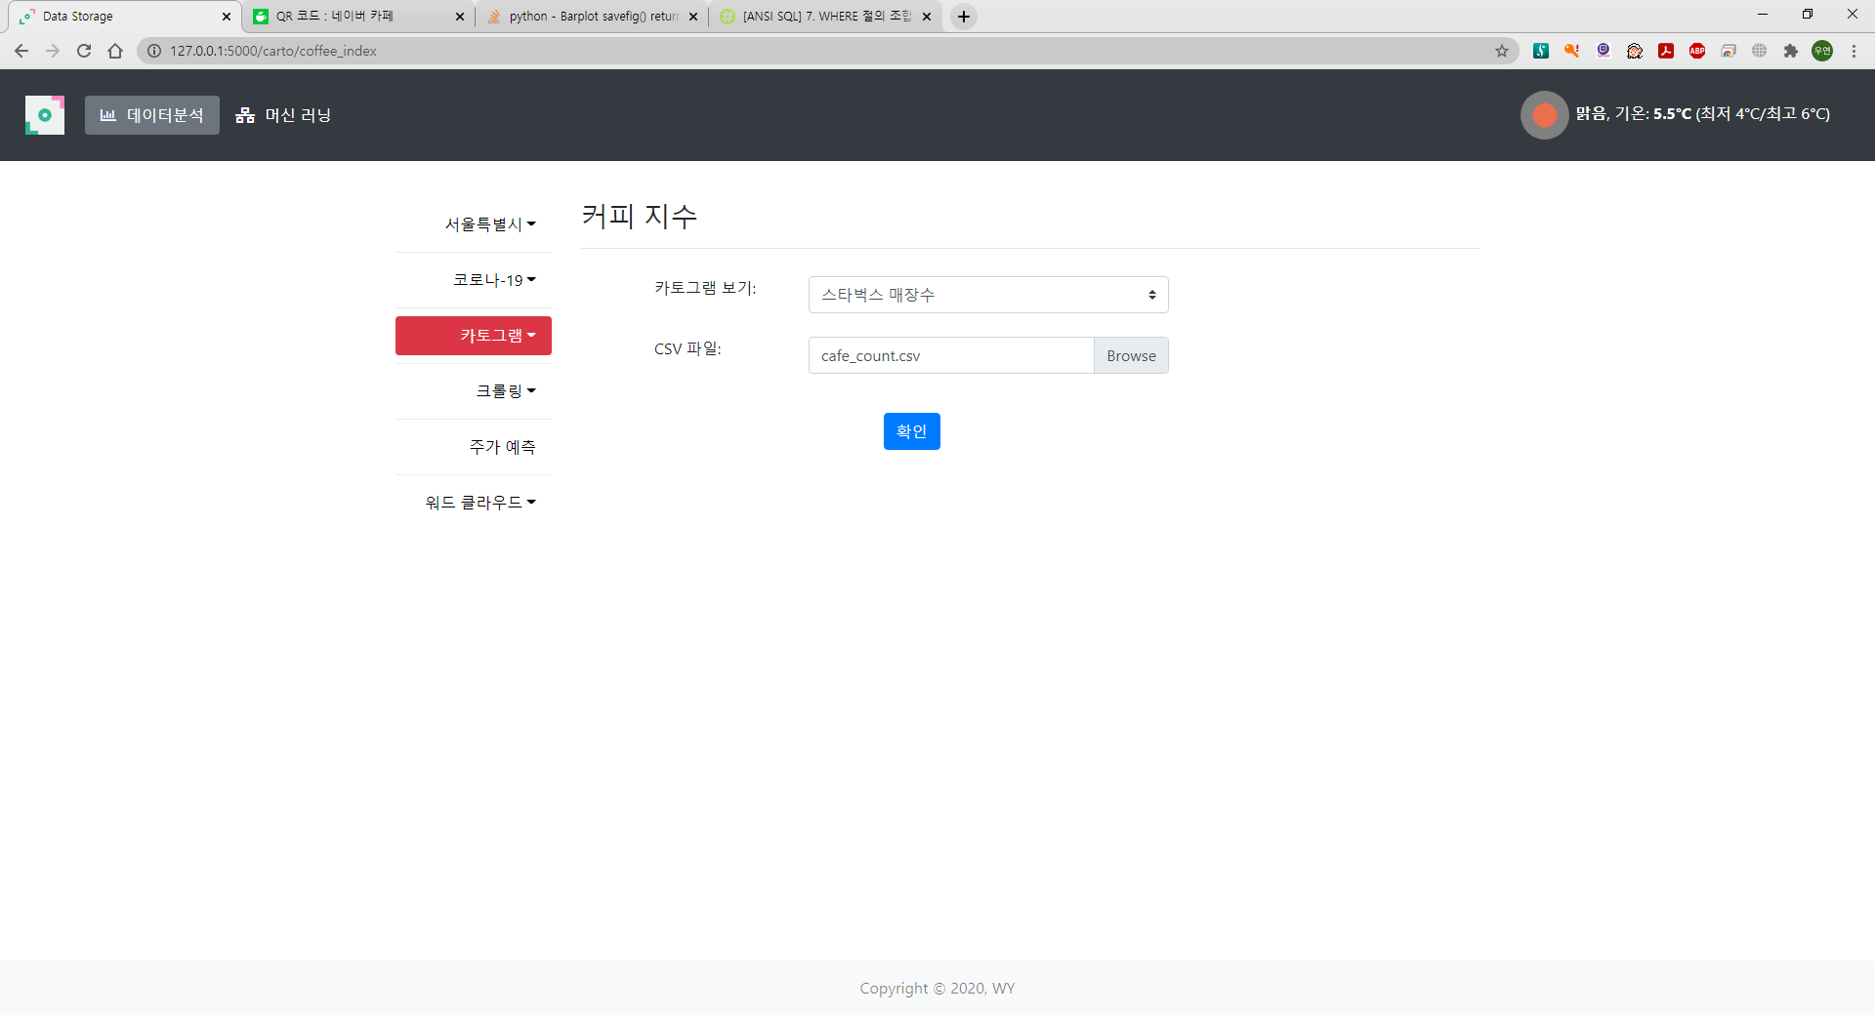

Slide 47
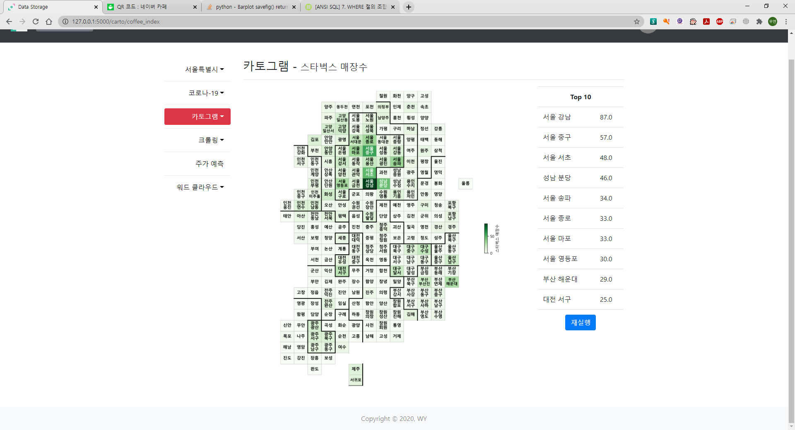

Slide 48
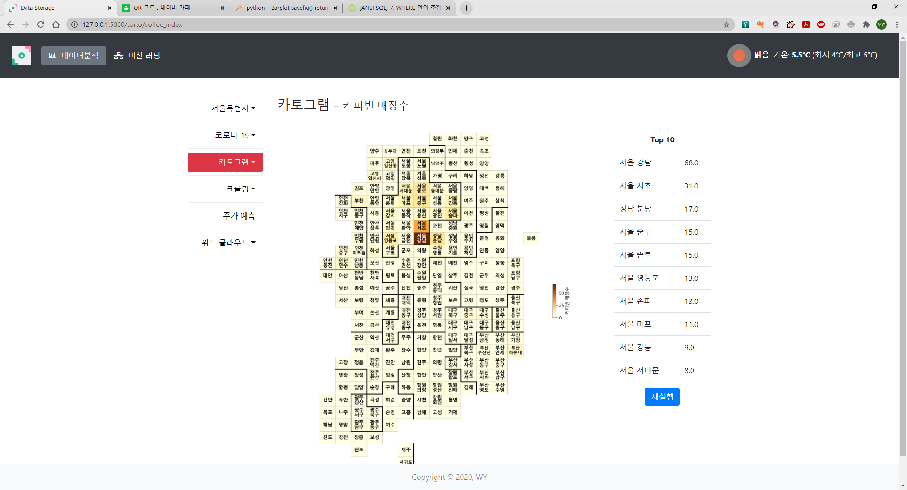

Slide 49
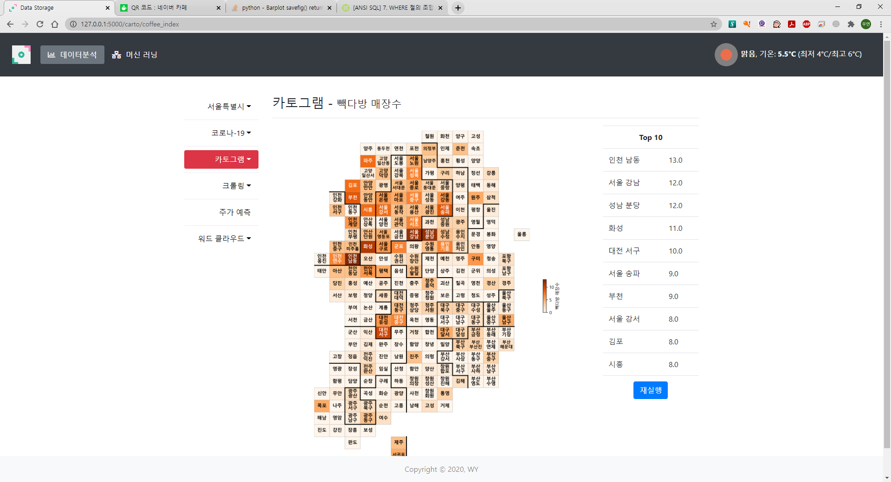

Slide 50
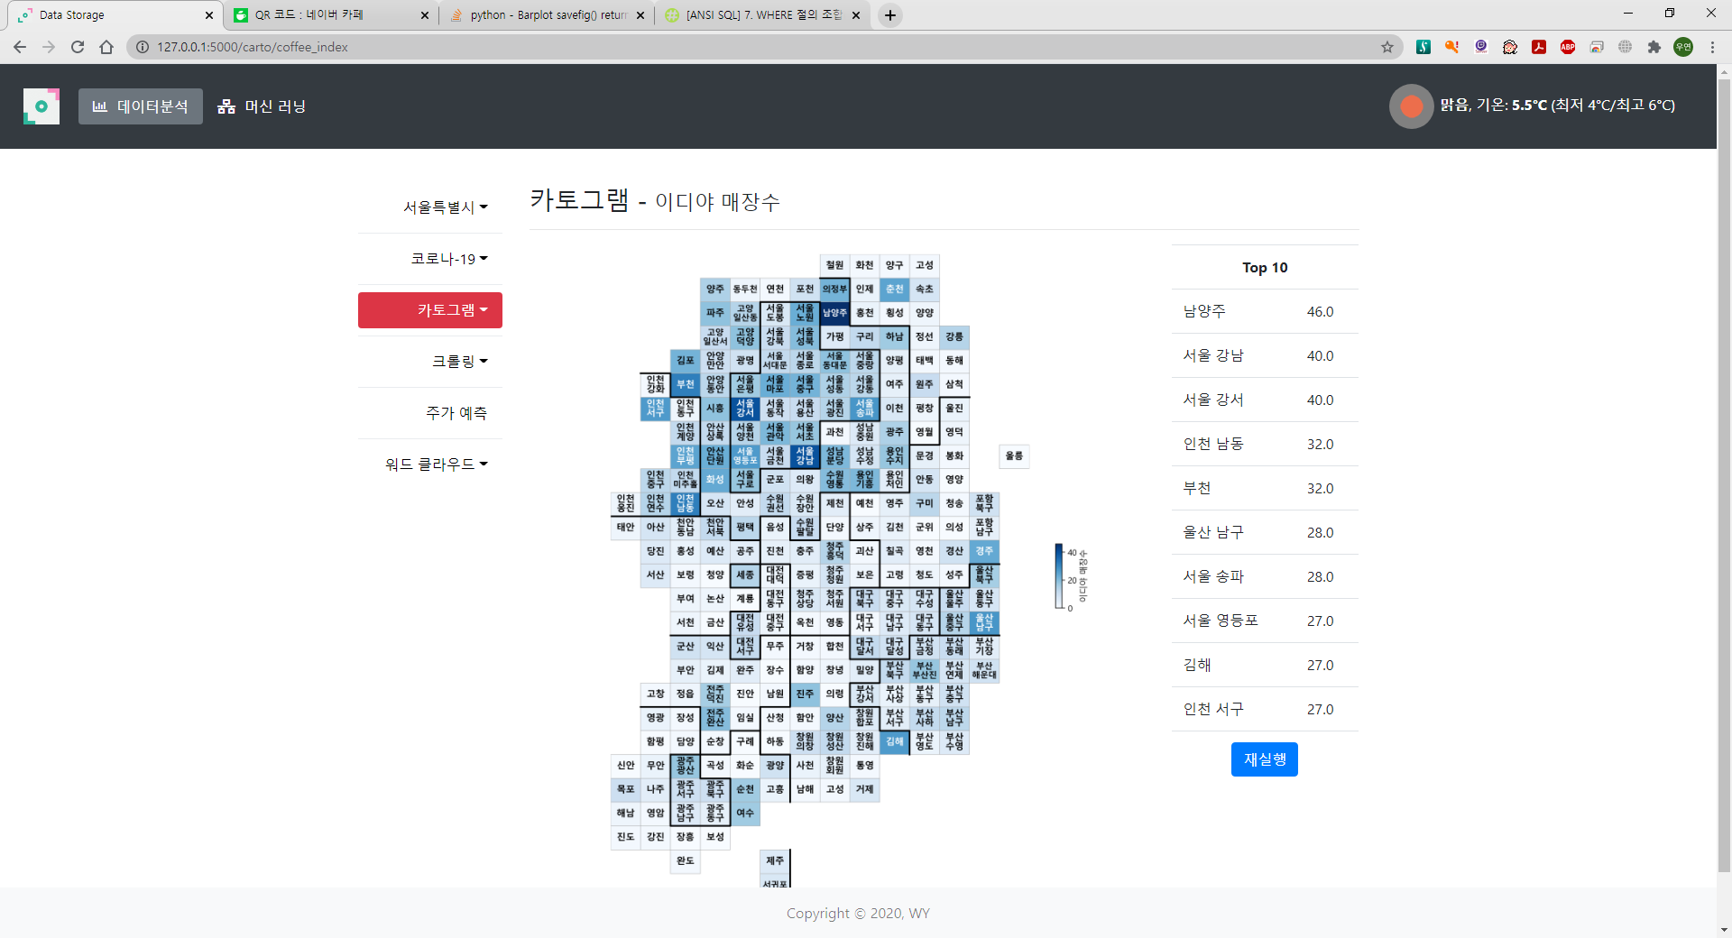

Slide 51
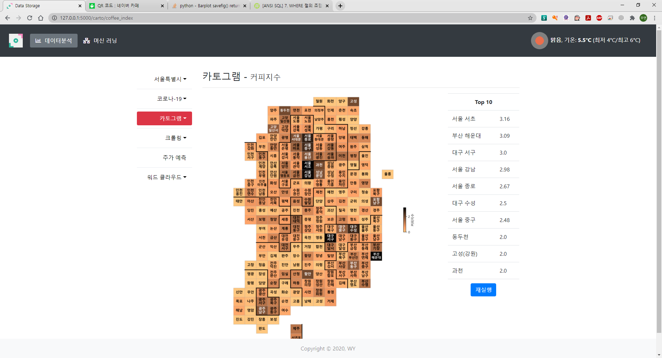

Slide 52
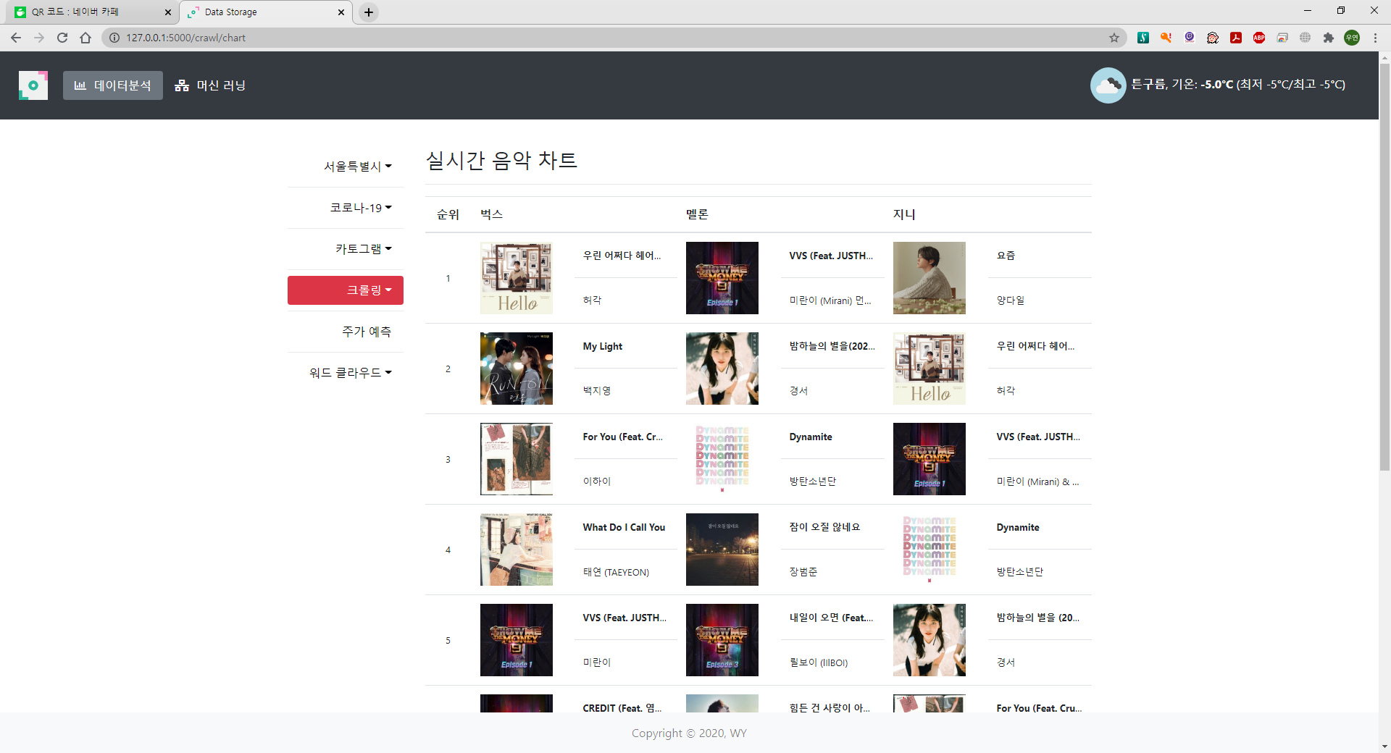
벅스, 멜론, 지니 실시간 차트

Slide 53
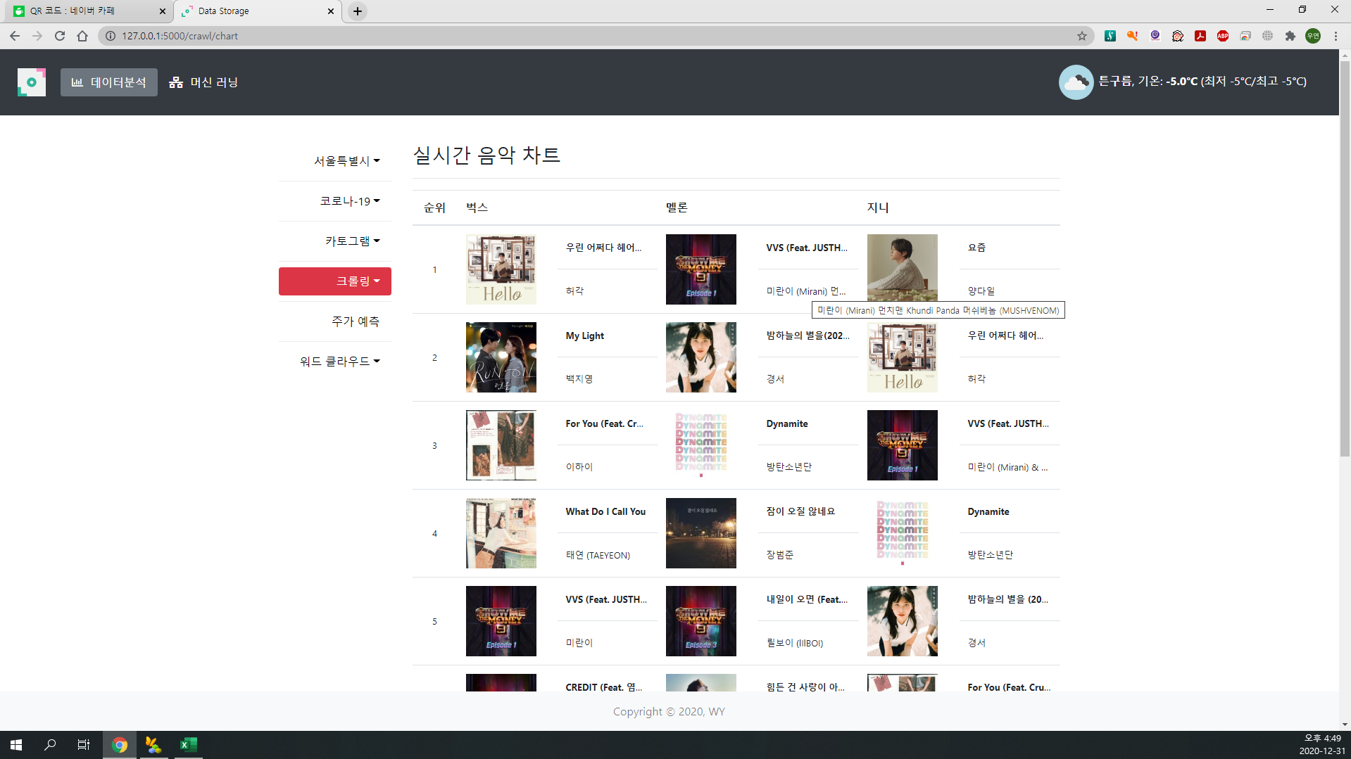
마우스 오버
툴팁

Slide 54
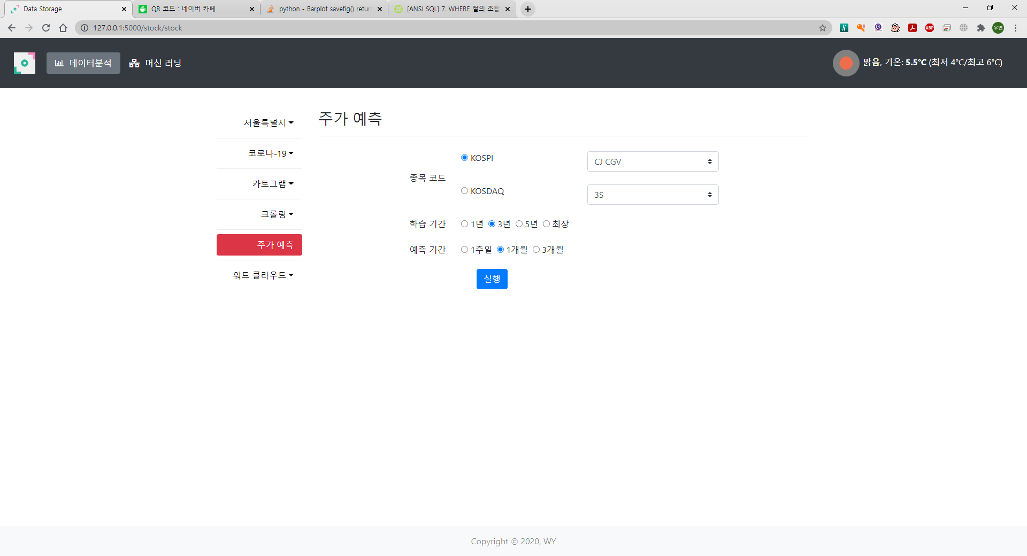

Slide 55
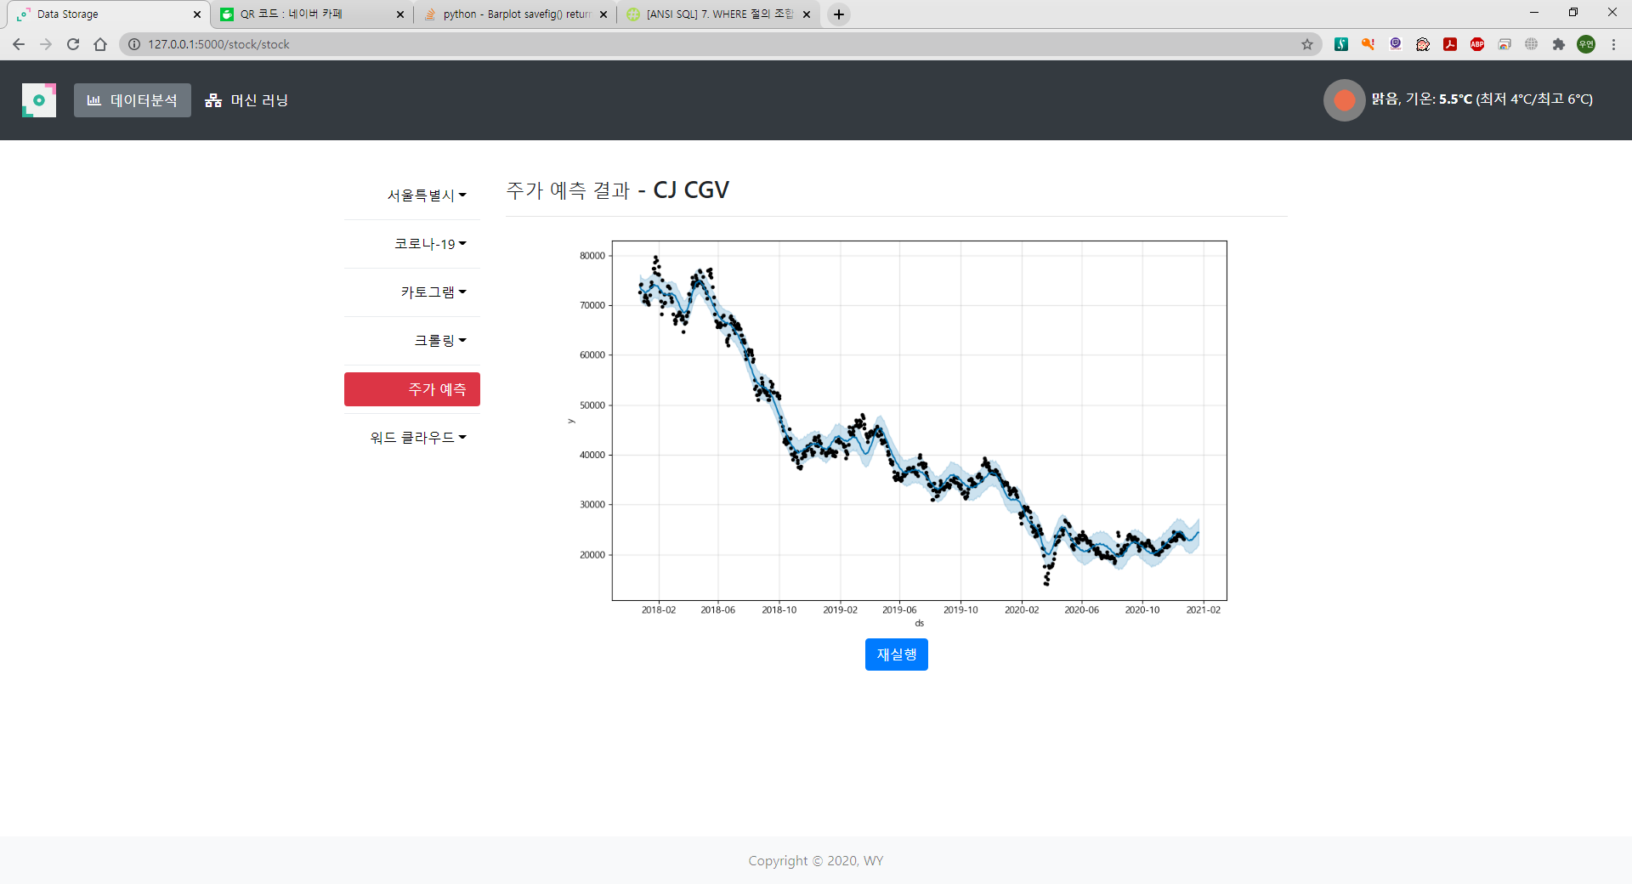

Slide 56


Slide 57
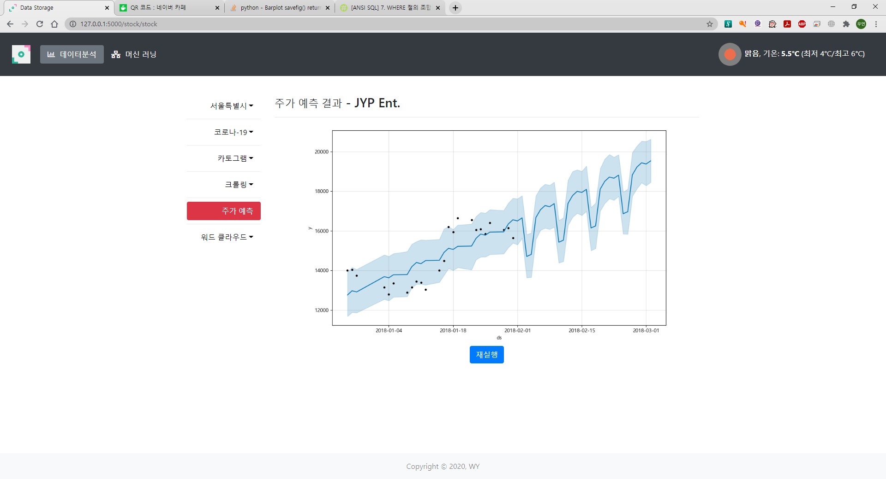

Slide 58
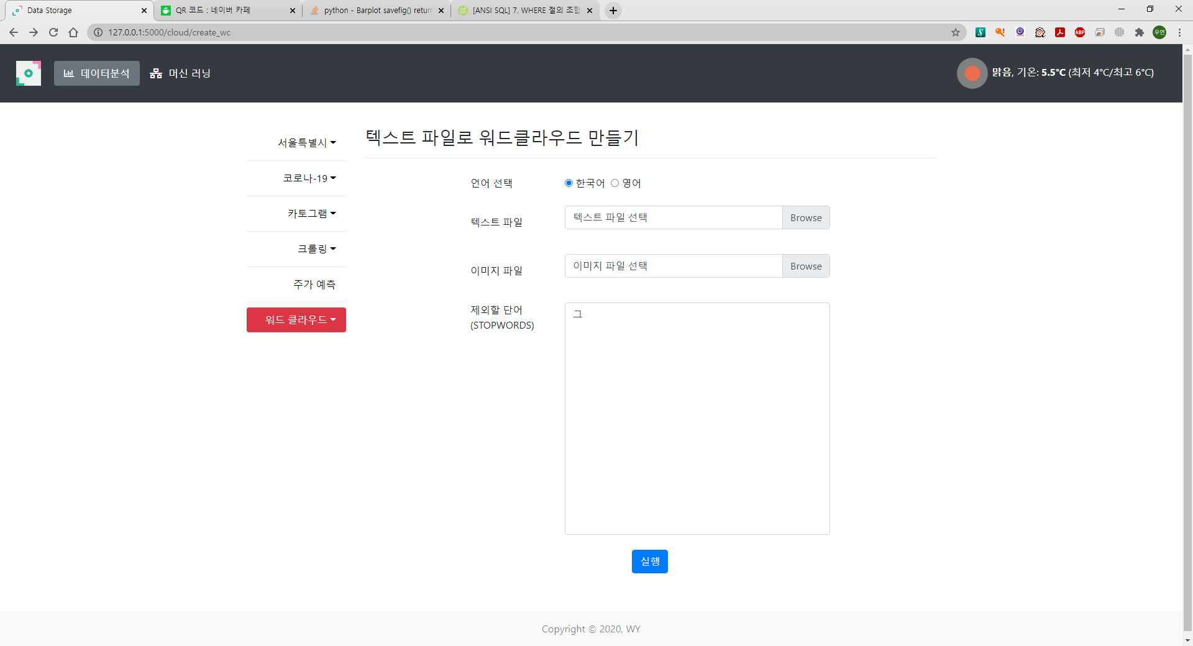

Slide 59
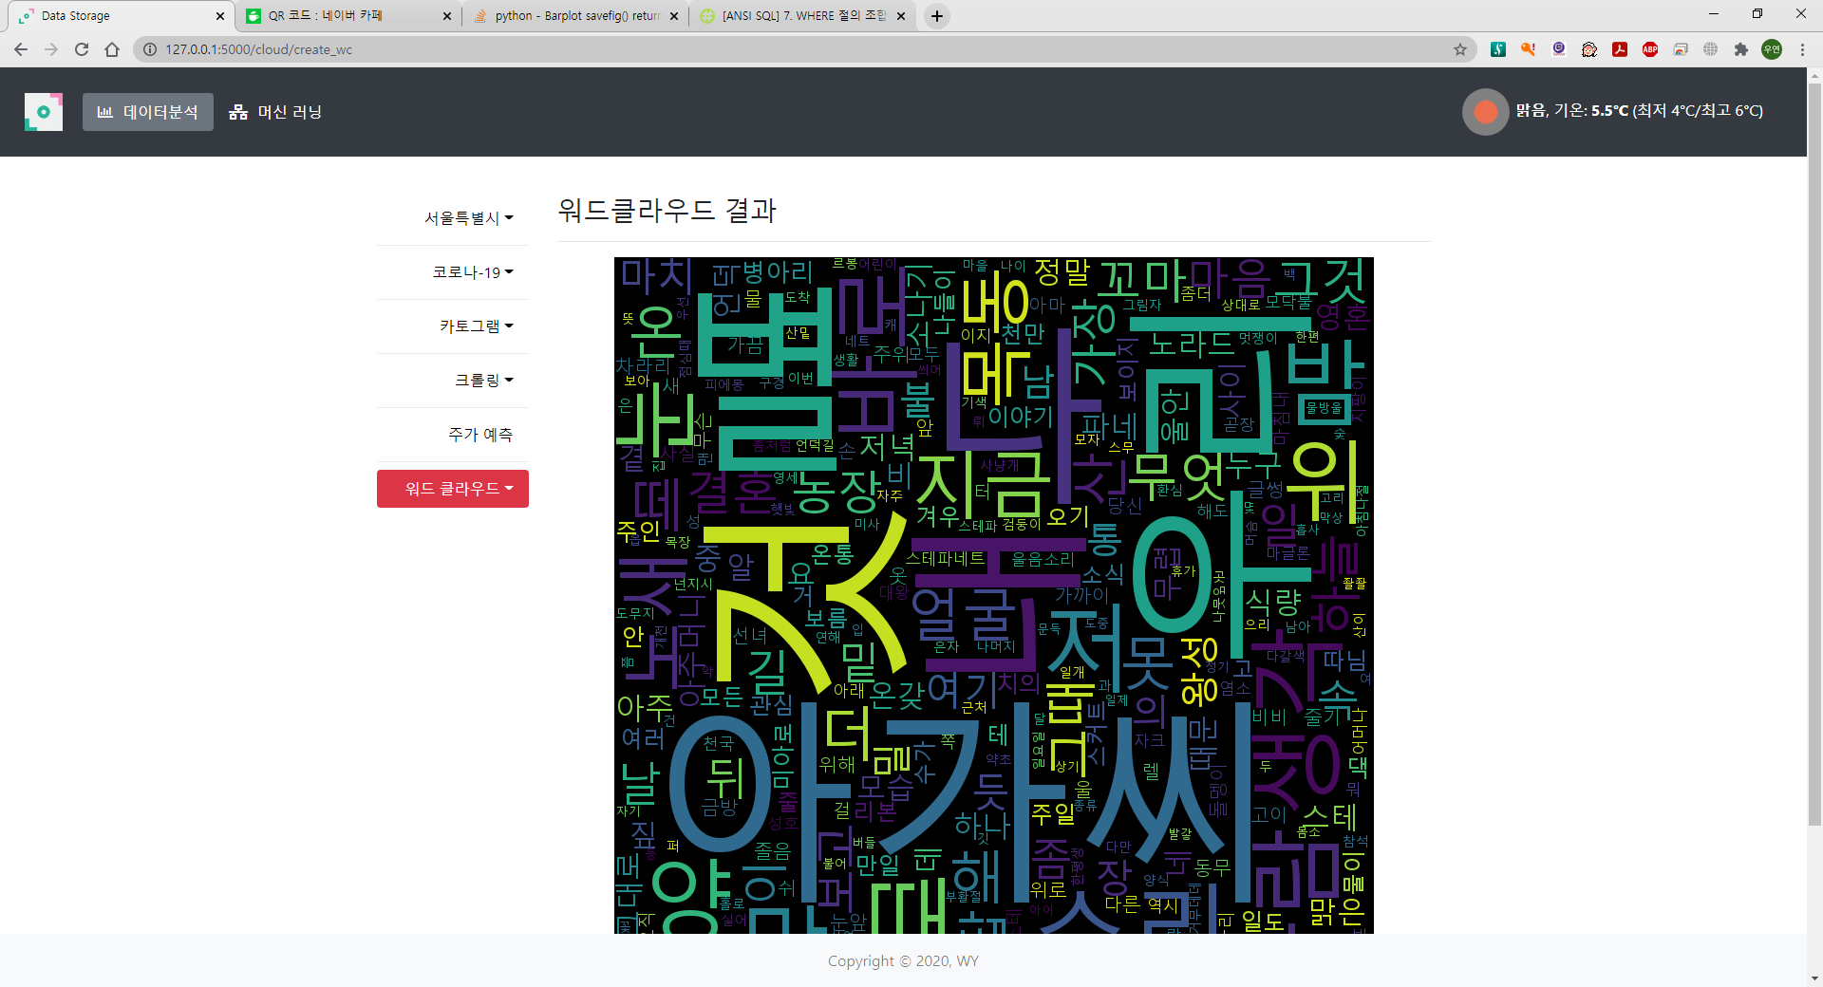

Slide 60


Slide 61
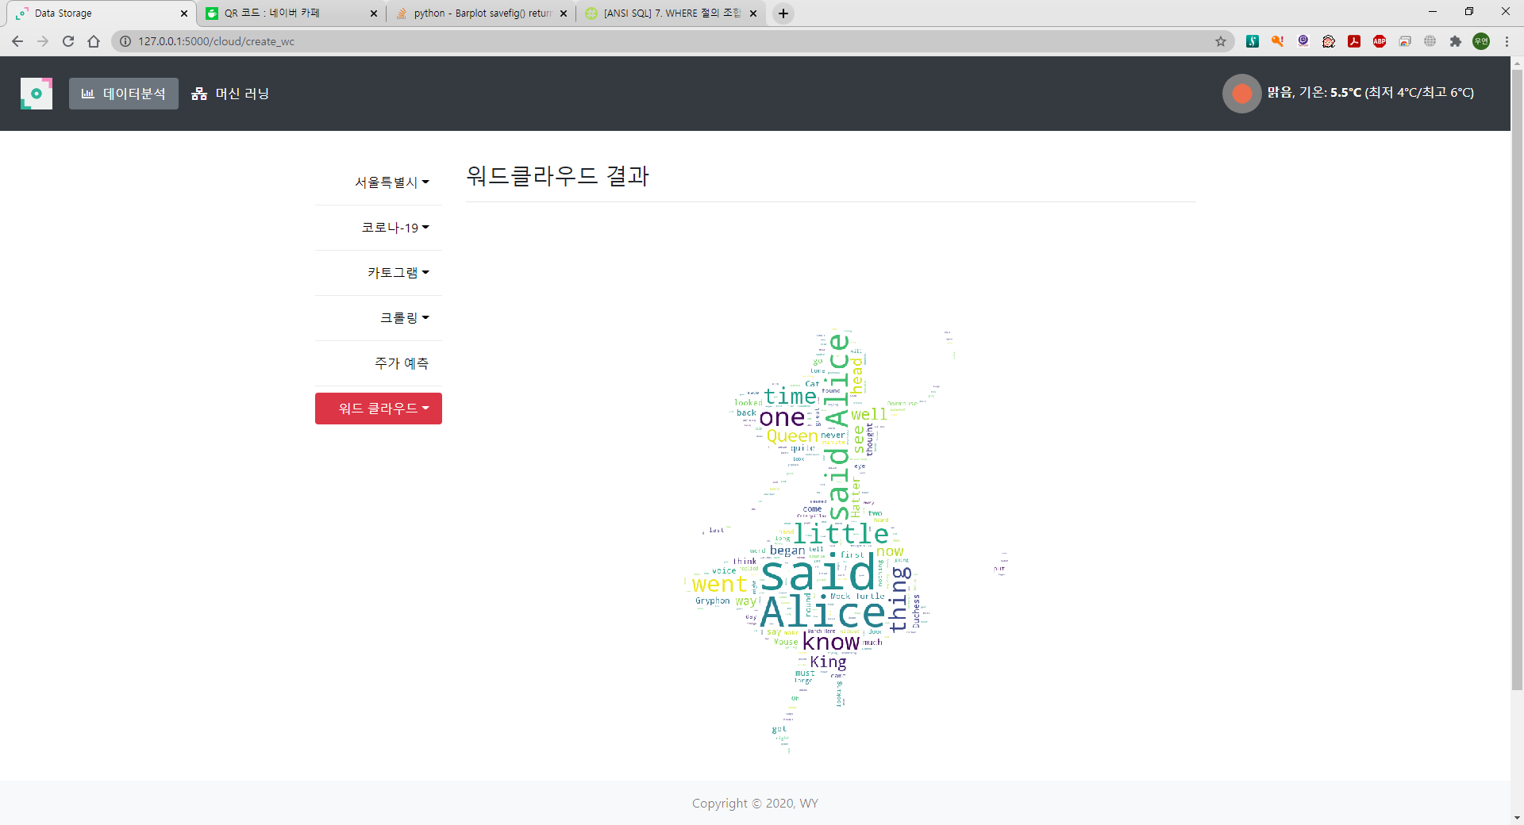

Slide 62
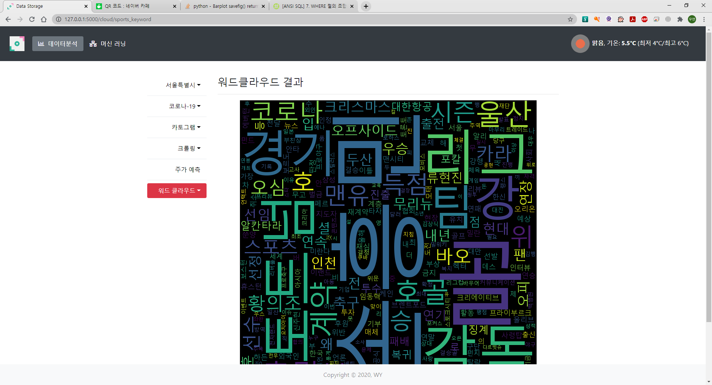
스포츠 뉴스 크롤링 후 워드클라우드

Slide 63
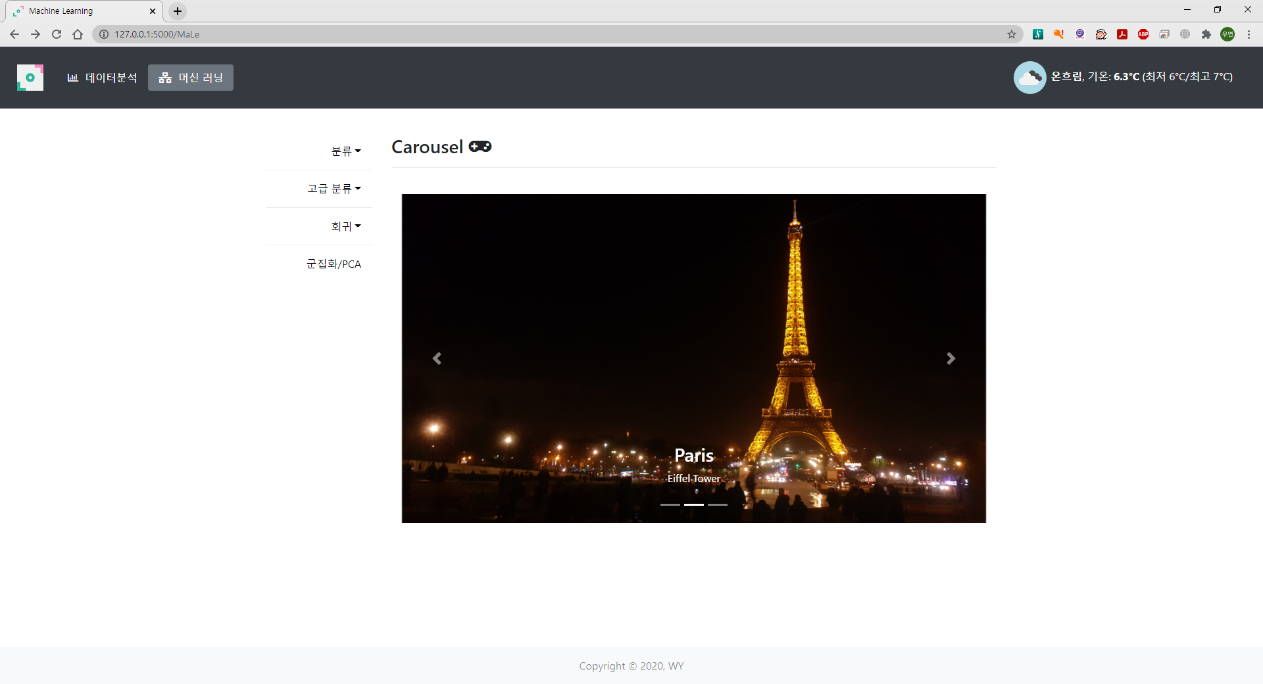
MaLe 화면

Slide 64

cancer.html

Slide 65

cancer_res.html

Slide 66

pima.html

Slide 67

pima_res.html

Slide 68

titanic.html

Slide 69

titanic_res.html

Slide 70

iris.html

Slide 71

iris_res.html

Slide 72

wine.html

Slide 73

wine_res.html

Slide 74

IMDB.html

Slide 75

IMDB_res.html
테스트 데이터

Slide 76

IMDB_res.html
리뷰 텍스트 입력

Slide 77

mnist.html

Slide 78

mnist_res.html

Slide 79

iris.html

Slide 80

iris_res.html

Slide 81

diabetes.html

Slide 82

diabetes_res.html

Slide 83

boston.html

Slide 84

boston_res.html

Slide 85

clust.html

Slide 86

clust_res.html

